Slide 1
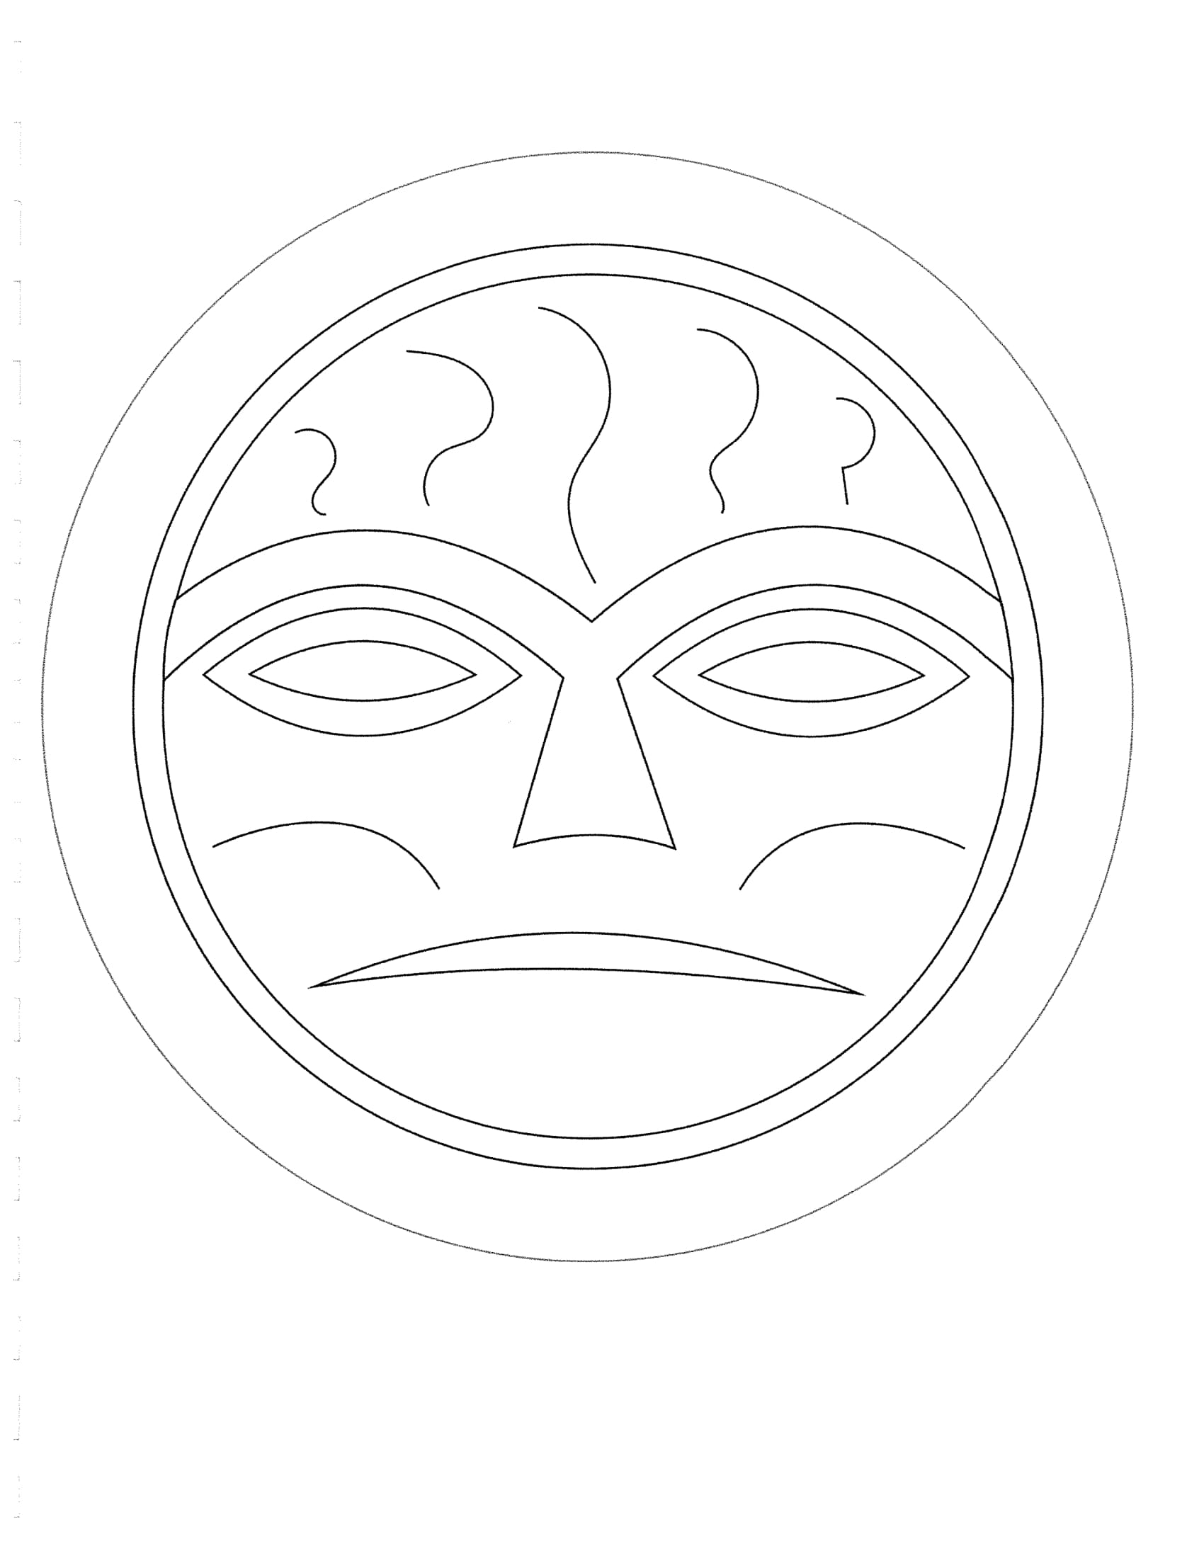
The Impacts of Assimilation
Confederated Tribes of Grand Ronde
High School Social Studies Lesson

Slide 2
In this lesson you will…:
learn a brief history of the Confederated Tribes of Grand Ronde.
participate in discussion with your small group and the whole group.
learn about the term “assimilation”.
think critically about what culture is.
work as a group to complete a worksheet at the end of the lesson.

Slide 3
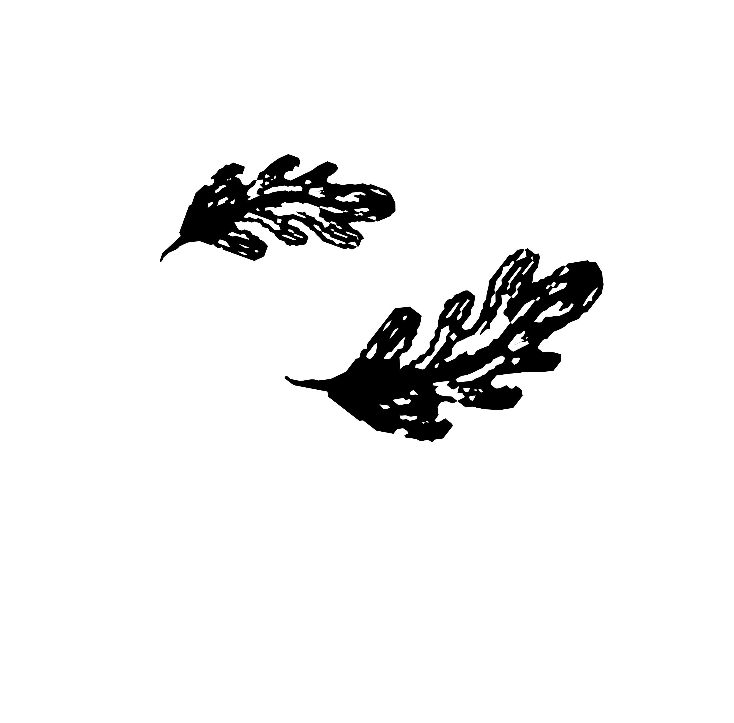
Brainstorm!
What is culture?

Slide 4
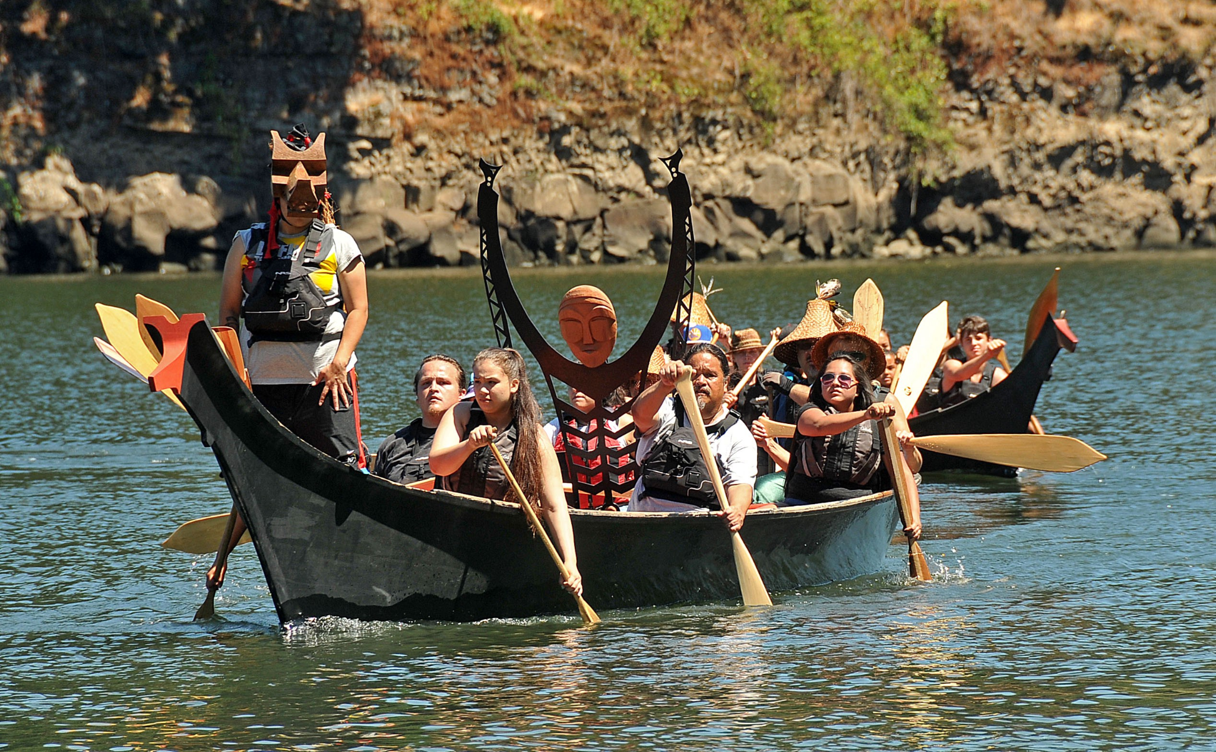
CULTURE
Culture is the characteristics and knowledge of a particular group of people, encompassing language, religion, cuisine, social habits, music, and art.
- Grand Ronde canoe paddlers -

Slide 5
What do you know about the Confederated Tribes of Grand Ronde?

Slide 6
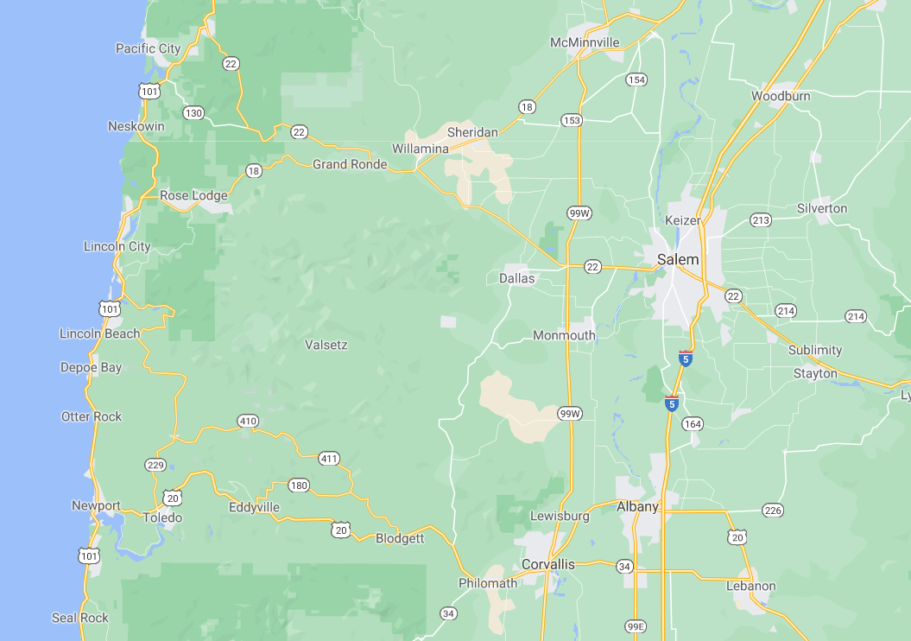

Where is Grand Ronde?

Slide 7
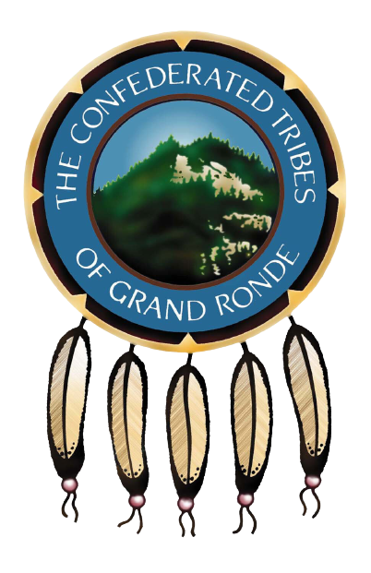
Who is the Confederated Tribes of Grand Ronde?
One of the nine federally recognized Native American tribes in Oregon.
Made up of more than 27 different bands and tribes across Oregon and brought together on the reservation in Grand Ronde, Oregon.
They have a unique culture, language and set of traditions practiced by their people.
The Grand Ronde government/ Tribal Council and campus is currently located in Grand Ronde, Oregon.
There are over 5,500 tribal member across the world.
CTGR Governance Building
CTGR Pow Wow dancers

Slide 8
A Brief History of CTGR
The Confederated Tribes of the Grand Ronde Community of Oregon includes over 30 tribes and bands from western Oregon, northern California, and southwest Washington. Since time immemorial tribal people have relied on these traditional landscapes for their livelihood. The fish and game were plentiful and what the lands didn’t provide, they acquired by trade.
This way of life changed with western expansion. Ratified and unratified treaties between the Tribes and the United States Government from 1853 through 1855 resulted in the forced removal of tribal members from their ancestral homelands.
The Grand Ronde Tribe’s federal recognition status was terminated in 1954 when Congress passed the Western Oregon Termination Act. This legislation stripped the Tribe of its federal status and severed the trust with the federal government. Between 1954 and 1983, Grand Ronde tribal members were a landless people in their own land. The termination policy robbed the Tribe of its social, economic and political fabric, leaving a scattered population and poverty.
During these times of removal and termination, the United States Government placed requirements and restrictions upon the Native peoples in attempt to eliminate their cultural practices and lifeways.
In 1983, the federal recognition status of the Confederated Tribes of Grand Ronde was restored. After restoration and the re-establishment of the Grand Ronde Reservation were completed, the Tribe focused on rebuilding its institutions and developing programs to meet the needs of its members.
For more information and more specifics regarding this information, visit: https://www.grandronde.org/history-culture/history/our-story/

Slide 9
Brainstorm!
What is assimilation?

Slide 10
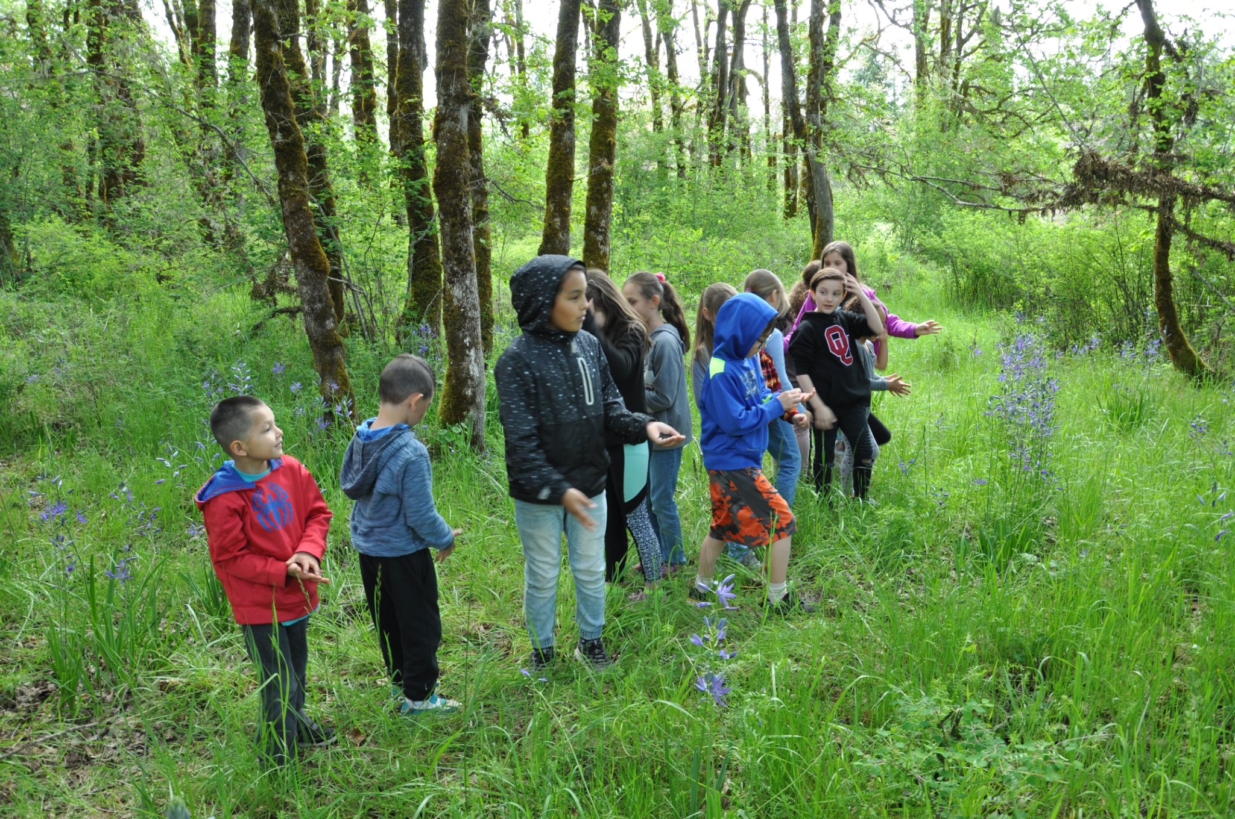
ASSIMILATION
Assimilation is the process of a group’s language and/ or culture coming to resemble those of another group.
- Grand Ronde students planting camas -

Slide 11
Brainstorm!
Could assimilation be considered harmful, helpful, or both?

Slide 12
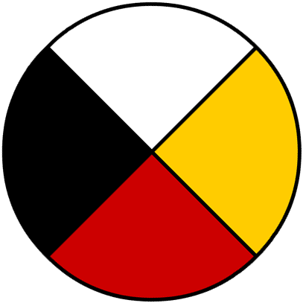
Consider these aspects of health:
This is the medicine wheel and many Native peoples utilize this structure as a balance for a person’s health.
Could assimilation have affected any or all of these aspects of health for Native people from Grand Ronde?
Emotional
Mental
Physical
Spiritual

Slide 13
Brainstorm!
How do you think assimilation would have affected the people of Grand Ronde?

Slide 14
Aspects of Culture and Native Life that Were Affected
Loss of Language
Diet
Family structures
Location (where people lived)
Hunting/ fishing practices
Access to native resources
Ceremonies were forgotten
Connections to community
Traditional songs and dances were lost
Access to illegal substances (alcohol and drugs)
Social gatherings
Introduction of different religions

