Slide 1
Language Revitalization
The Confederated Tribes of Grand Ronde

Slide 2
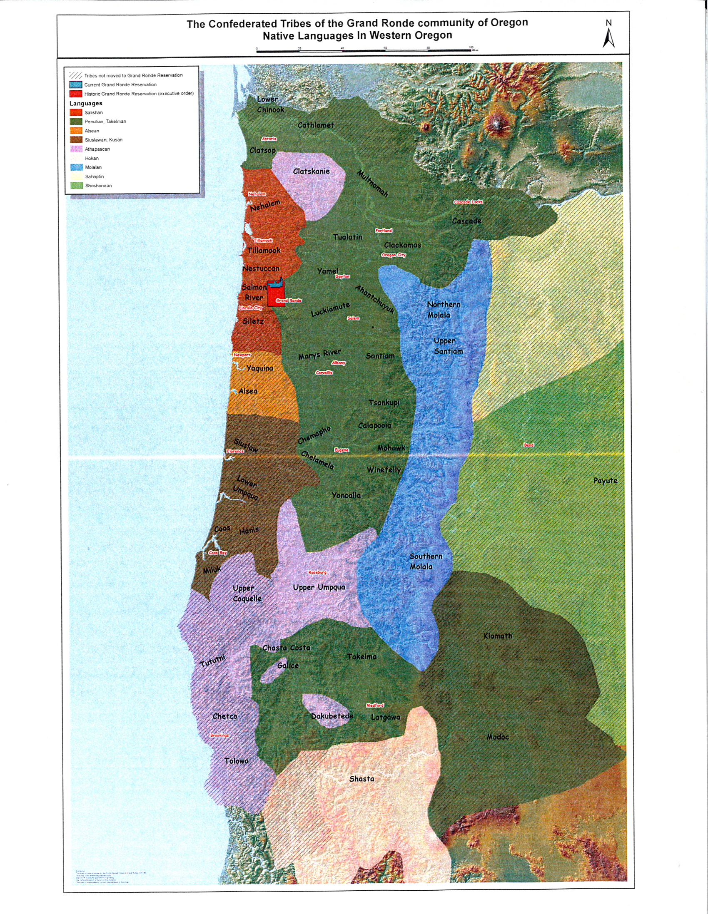
Native Languages in Western Oregon
This map, from the Confederated Tribes of Grand Ronde, demonstrates the various languages that were spoken throughout the Willamette Valley by different tribes.
It is estimated that there was 25-35 native languages spoken in Oregon prior to Euro-settlers, though only nine of them are spoken fluently today.
Notes:
*A larger version of this map is available as an attachment to this lesson

Slide 3
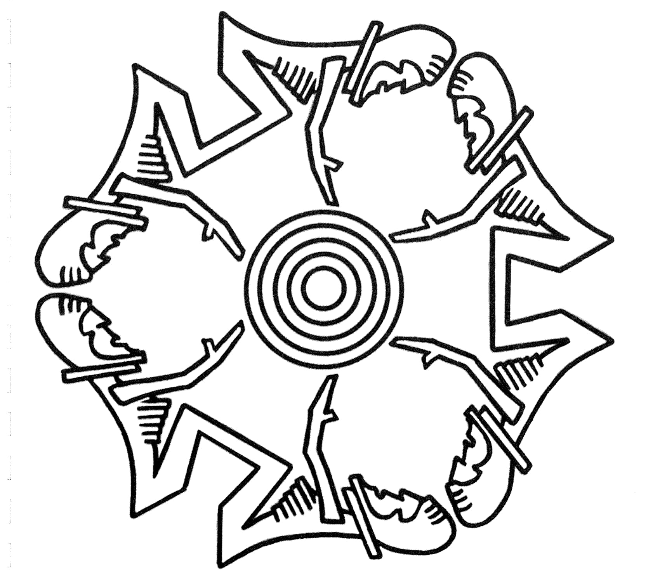
Reflect
Why do you think only nine tribal languages are fluently spoken in Oregon today?
Notes:
Pause and pose this question to students. Have students think to themselves for a moment and then share with a partner. Come back as a class and have a few students share their answers.

Slide 4
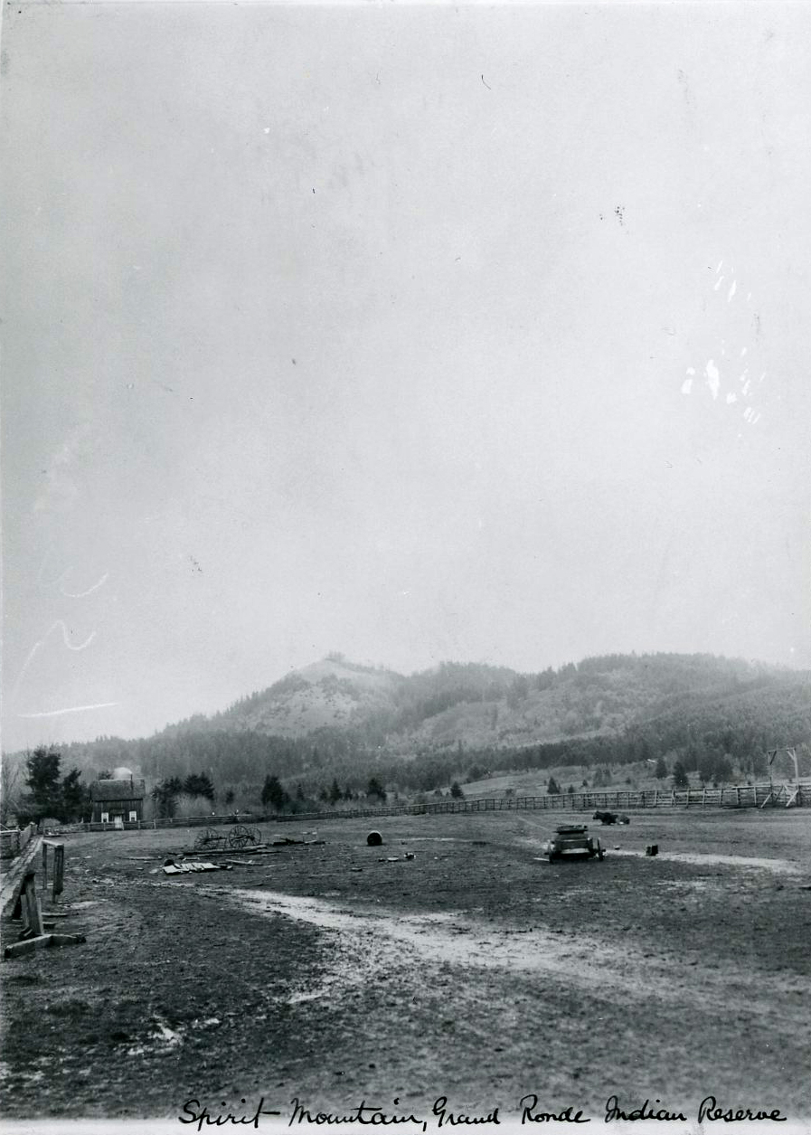
In 1855 tribes in Oregon began being forced onto reservations
Notes:
•During the discovery of gold in 1852 and the Oregon Donation Land Act of 1850, settlers flooded Indian Country via the Applegate Trail.
•Much of the land and their resources to survive were taken and dispersed.
•A reservation is land held for special use, in this case a place for Indians.

Slide 5
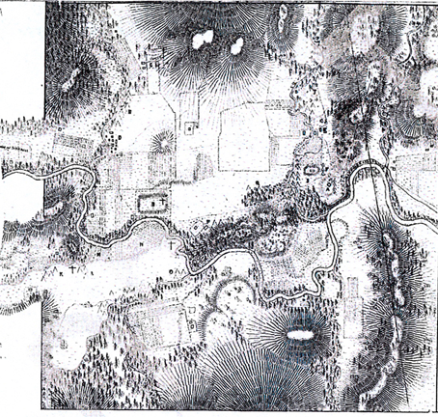
There were over 30 bands and tribes of people who were brought to the Grand Ronde Reservation.
Notes:
Each band and tribe spoke their own language. The first common language of the reservation was not English, but a Native language called chinuk wawa.

Slide 6
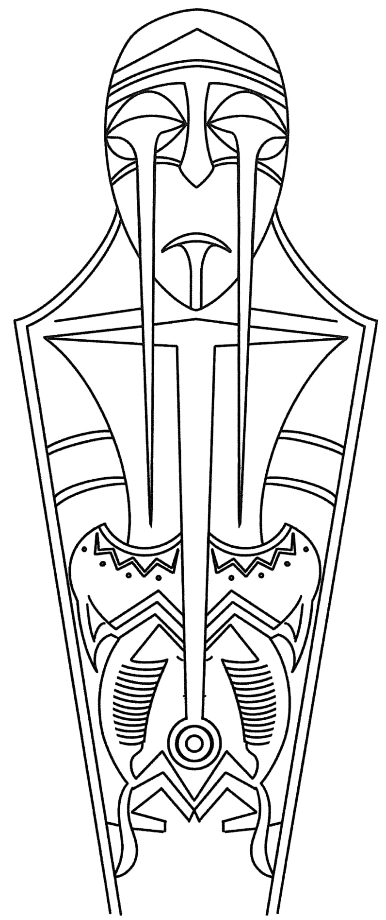
chinuk wawa
“chinuk wawa is an intertribal hybrid language indigenous to the Pacific Northwest, where it served as a regional lingua franca facilitating communication between speakers of different tribal languages as well as between tribal people and speakers of English and Canadian French.” (chinuk wawa, 2012, p.13).
Notes:
chinuk wawa was earlier developed by Native people along the Columbia River, to communicate with traders and foreigners. This became the first language that people on the reservation used to communicate with each other. When people got married they usually wouldn’t marry someone from their tribe. They would usually marry someone from another tribe who spoke a different language. Most often they would use chinuk wawa to communicate. This chinuk language was spoken in the home and the first language that many children would hear and learn.
Note: chinuk wawa doesn’t use upper and lower case letters, that is why when you see chinuk wawa text it is not capitalized.

Slide 7
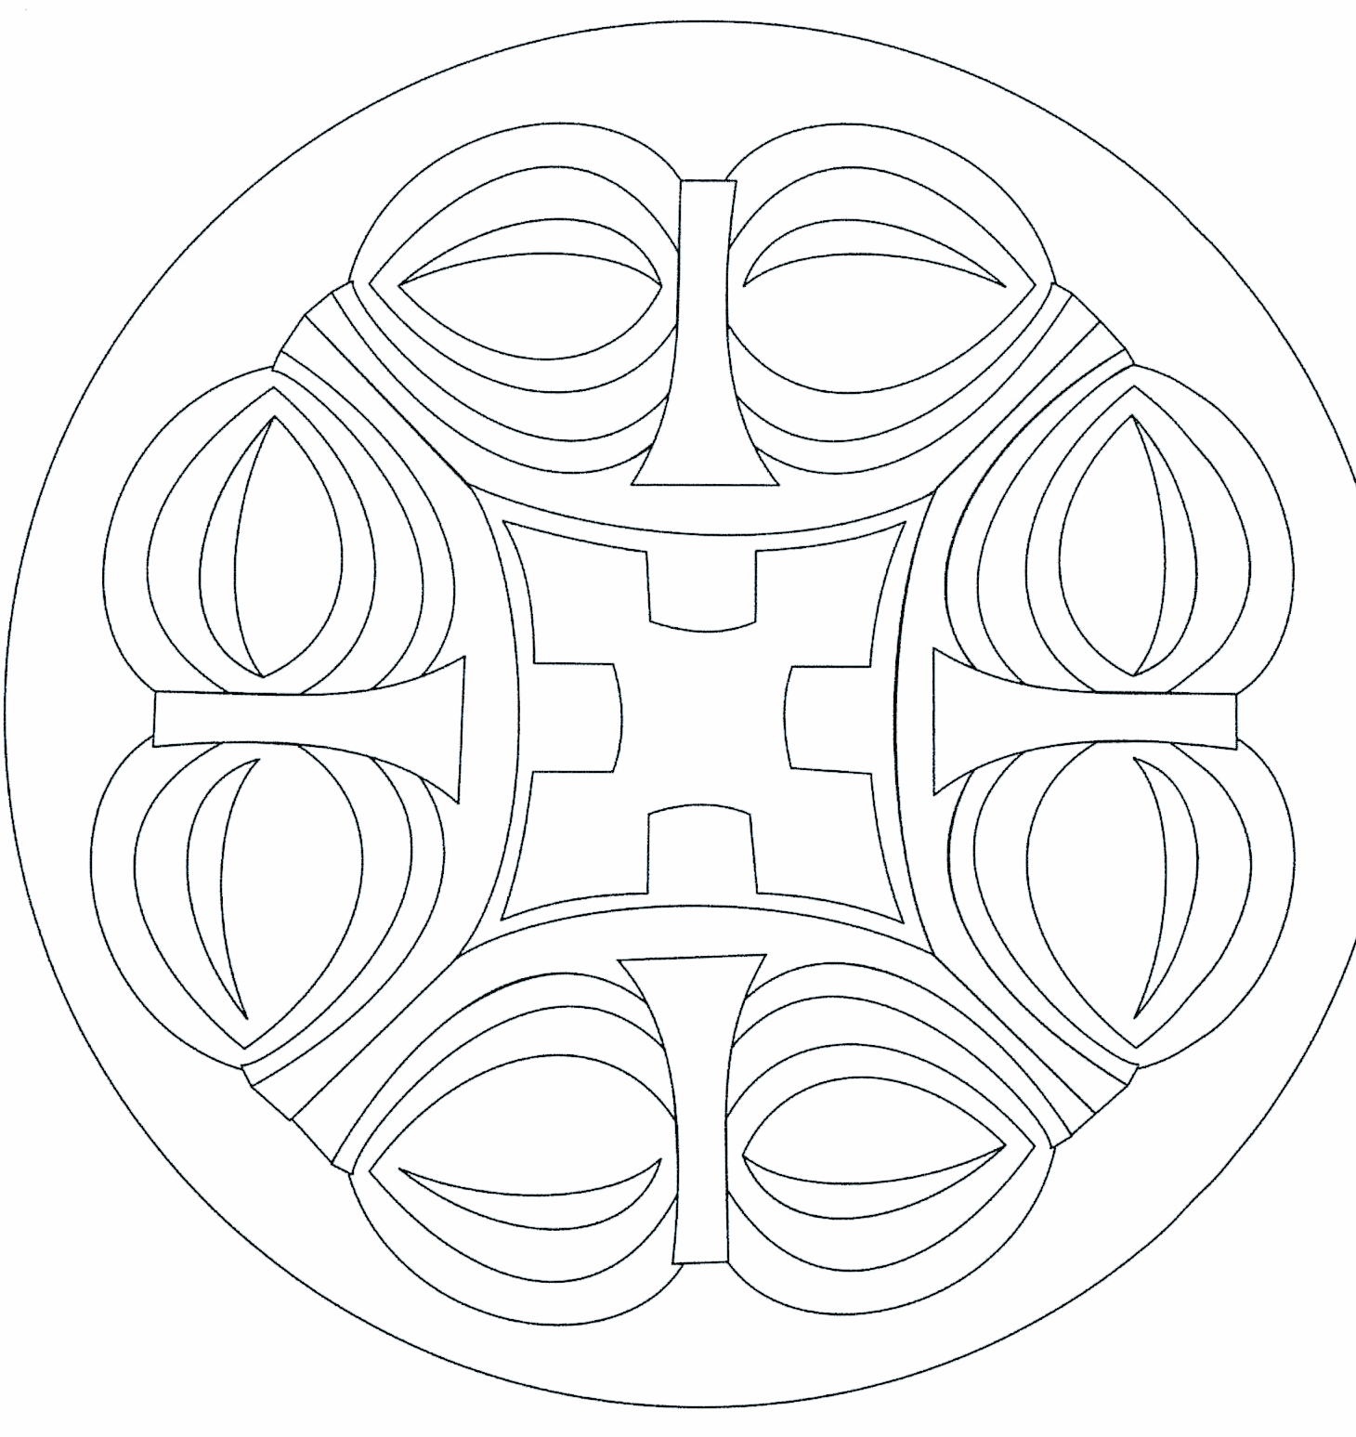
When the government forced the Native people to the reservation, they wanted the Tribes to assimilate and live like the European people.
“Kill the Indian, and Save the Man”
-Capt. Richard H. Pratt on the Education of Native Americans
What do you think it means to assimilate?
Why would the US government want to assimilate the Tribes?
Notes:
They started forcing the Native people to send their children to boarding school. A boarding school meant that the children lived at the school and they only came home on vacations and sometimes on holiday breaks. The goal of these schools were to “civilize” the Native children. The children were made to wear clothes like the European people and eat food as they did as well. They were also not allowed to speak their Native language. In fact, they were punished if they did. Many families stopped teaching their children chinuk wawa, so they wouldn’t be punished at school for speaking it. However, chinuk wawa continued to be used with older people in the community, with the result that chinuk wawa survived far longer than the reservation boarding school era did.

Slide 8
Language Survival
In 1954 the Tribe was terminated, meaning the U.S. Government no longer recognized them as a tribe. During termination, many Tribal Members moved away to find work. The number of chinuk wawa speakers continued to decline.

Slide 9
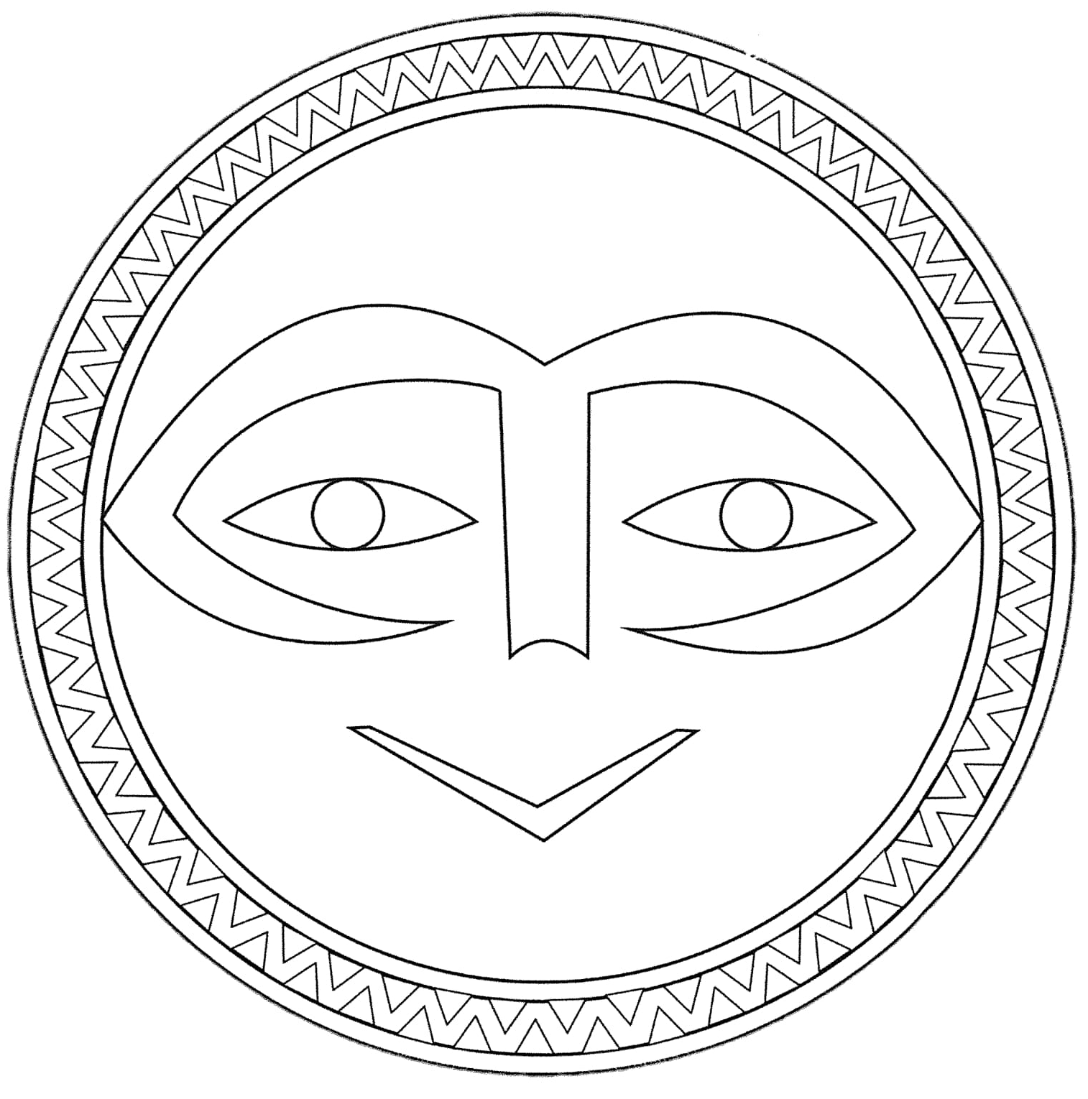
Restoration
After being terminated for almost 30 years, the Confederated Tribes of Grand Ronde was restored in 1983, gaining back their federal recognition.
Notes:
In the late 1970’s and early 1980’s a few elders conducted community classes in chinuk wawa, trying to keep it alive. Also at that time, there was a scholar who came through and he recorded elders speaking the language. He also learned to speak it. In 1997 The Confederated Tribes of Grand Ronde hired a language specialist who organized a program to revive Chinuk Wawa. He began teaching community classes and getting more people to speak the language. He worked together with the scholar who had come through earlier, to create curriculum and lessons for these classes.

Slide 10
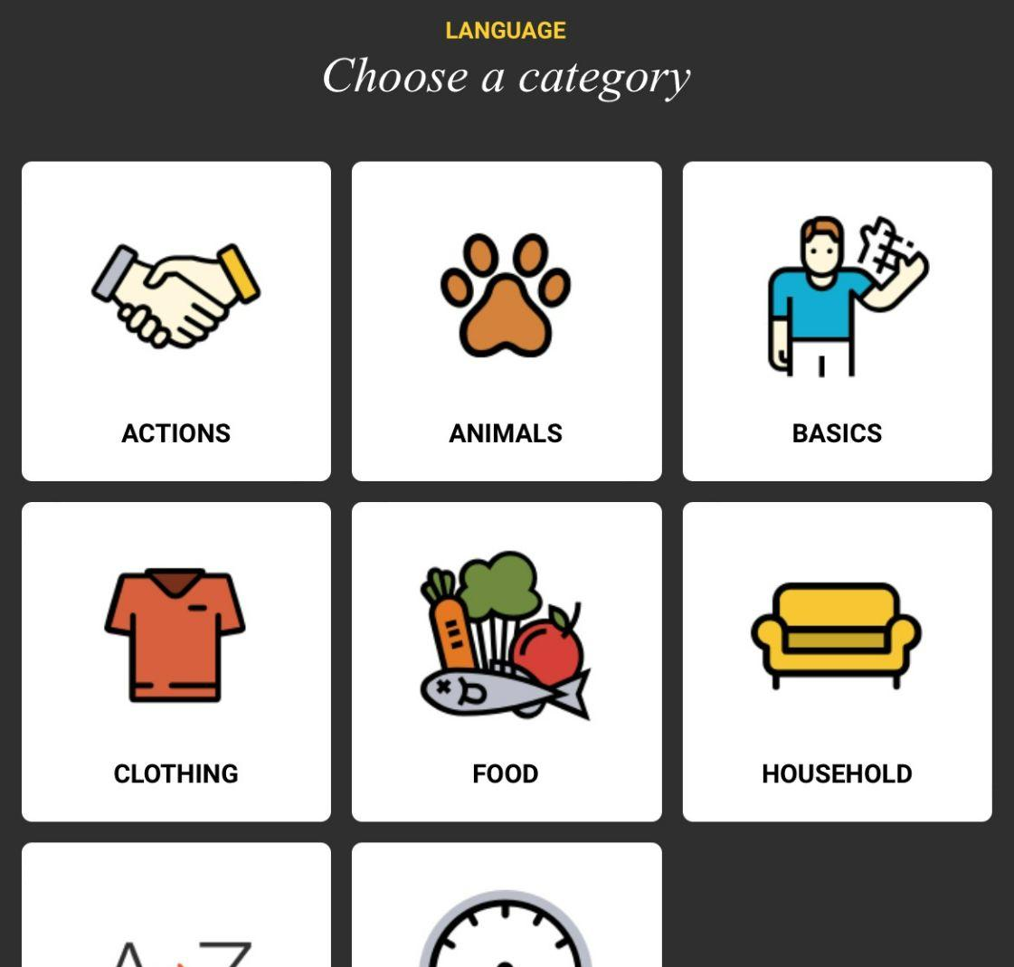
chinuk wawa today
Notes:
In 2000 they helped start a preschool immersion class at Grand Ronde. An immersion Kindergarten started in 2004. Currently, the program serves K-4th graders. You can also take the class at Willamina High School. Many community classes are held in order to get as many people as possible speaking the language. There is also a chinuk wawa language app available for use using iPhones or iPads.

Slide 11
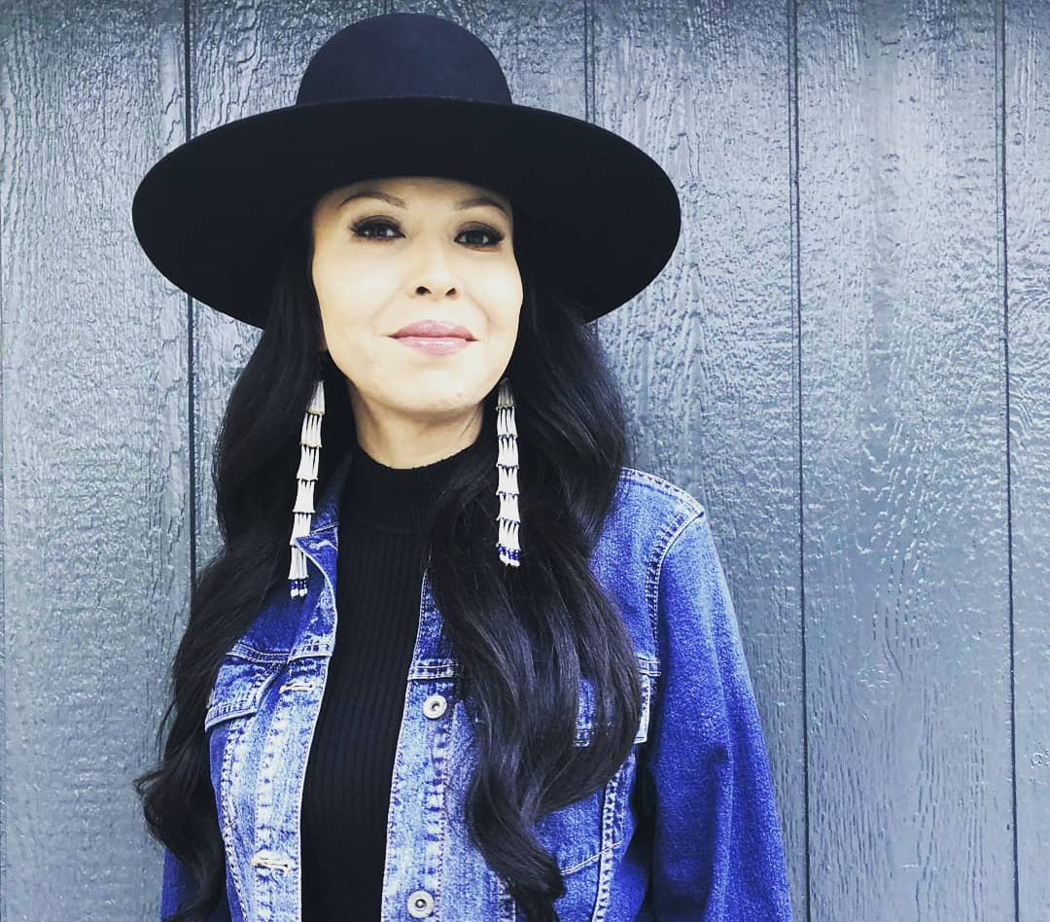
Crystal Starr Szczepanski
Crystal Starr Szczepanski is Athabascan, Yup'ik and Colville. She has worked for the Confederated Tribes of Grand Ronde since 1997. One of her goals in both her personal and professional life is to advocate and share culture and her Indigenous Language. A couple of her greatest accomplishments in her life is being invited to speak at various Indigenous Language Conferences and having her artwork shown in exhibits. This was a product of her commitment and dedication to becoming a master language speaker, learning traditional lifeways, and being self-taught in contemporary art.

Slide 12
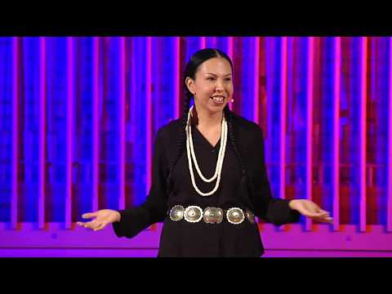
Notes:
Video Link: https://youtu.be/eKMSTkbtPBk

