Slide 1

Restoration
restoring our status and our people (tilixum)
Notes:
Chinuk Words:
people - tilixum

Slide 2
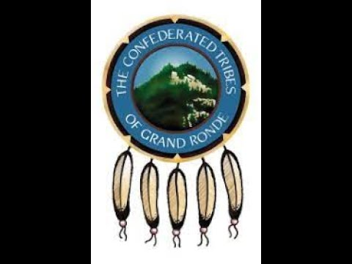
Restoration, The Confederated Tribes of Grand Ronde
Notes:
9:48-24:04
Can continue watching if teacher would like but begins to cover post-restoration era

Slide 3
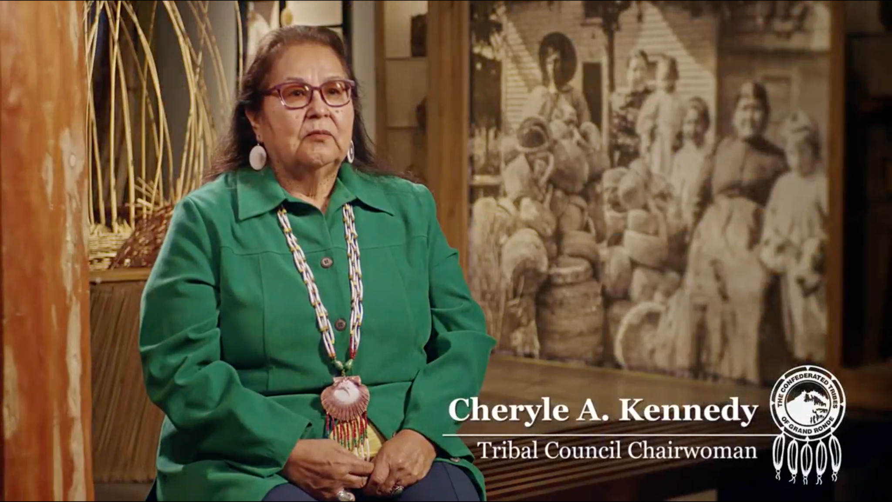

Restoring a People

