Slide 1

Sampling Data
Putting it all together
Notes:
Before teaching the lesson, please read the background notes for the teacher.

Slide 2
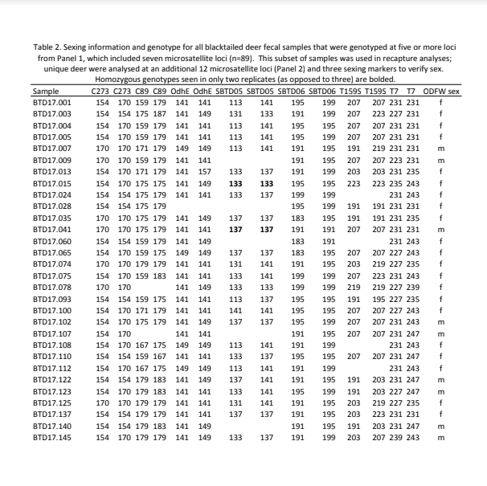
Review
What have we learned so far about blacktail deer populations?
What do we still need to know?

Slide 3
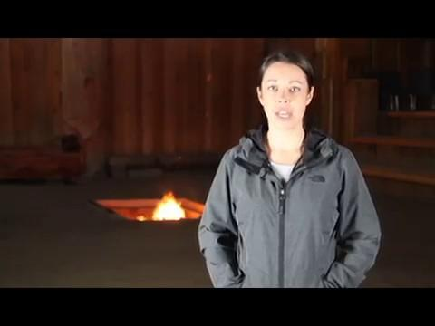

Slide 4
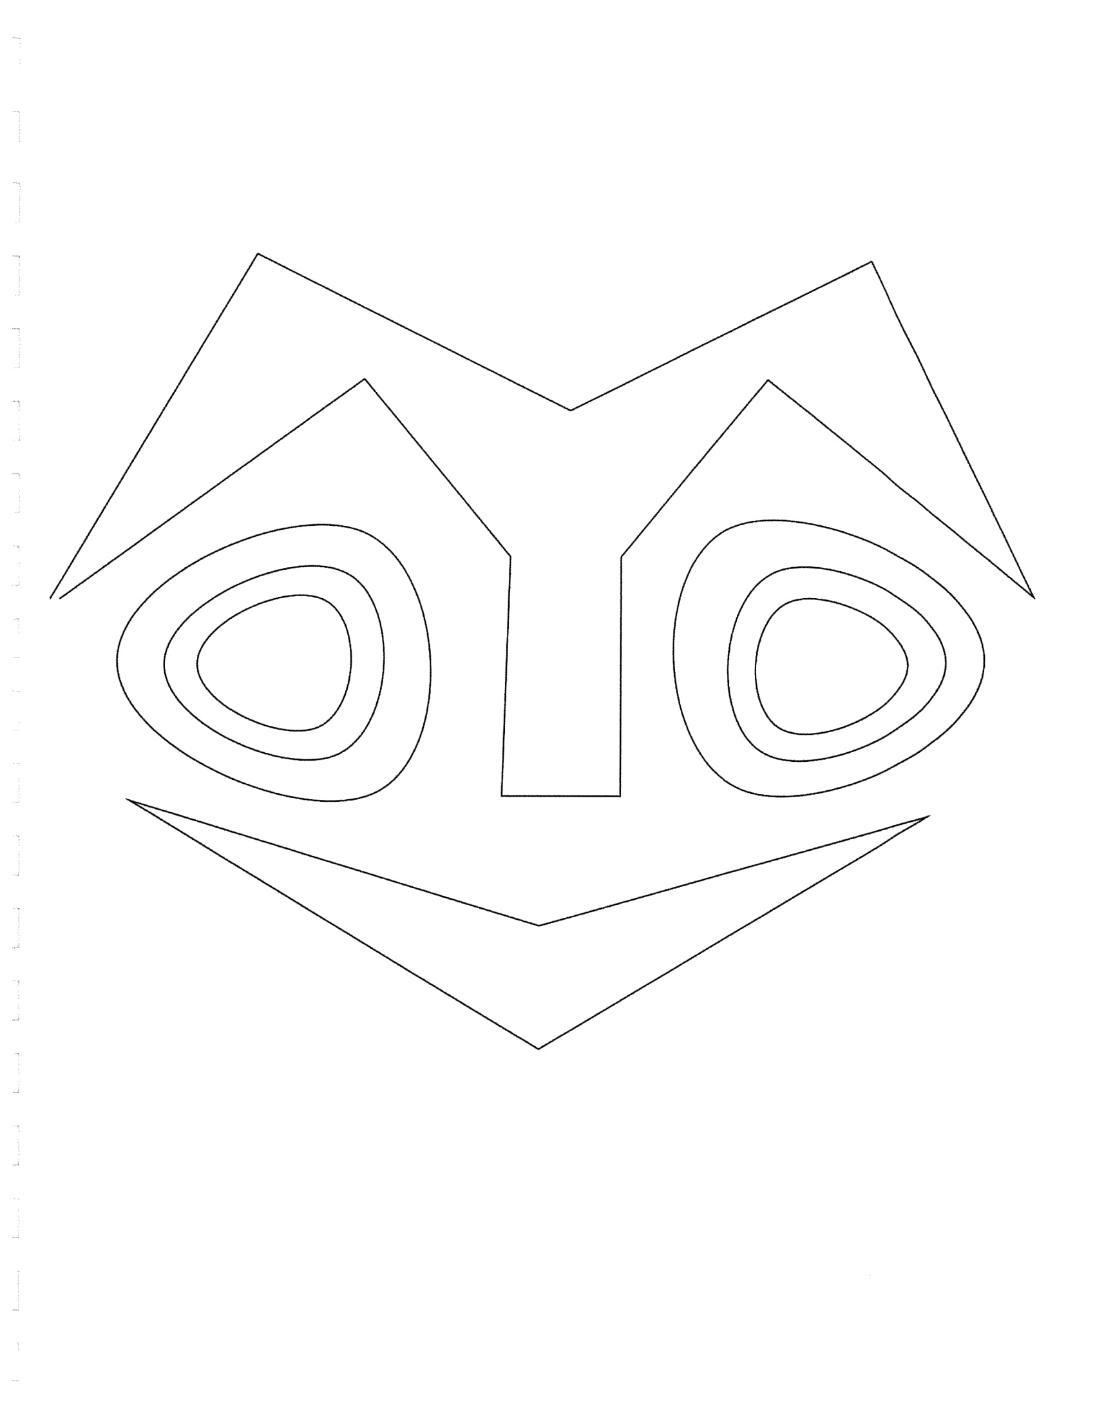
Using the Data
How does the wildlife biologist use the deer data to decide on the number of tags?

Slide 5

Class Noticings and Wonderings
How does the wildlife biologist use the deer data to decide on the number of tags?
Think, Ink, Pair Share
Think about what you heard in the video
Write a summary of the process
Share your process with your team

Slide 6
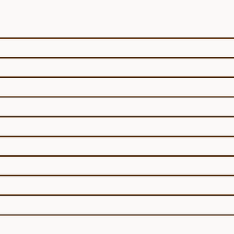

Make Your Prediction!
Based on the process you just summarized, determine the number of tags that should be issued based on the sampling data.

Slide 7
But What If...
some of the same deer are captured more than once?
In the Grand Ronde study there were…
289 Captures
89 Viable
19 were captured more than once
How does this impact the prediction of the total population?

Slide 8
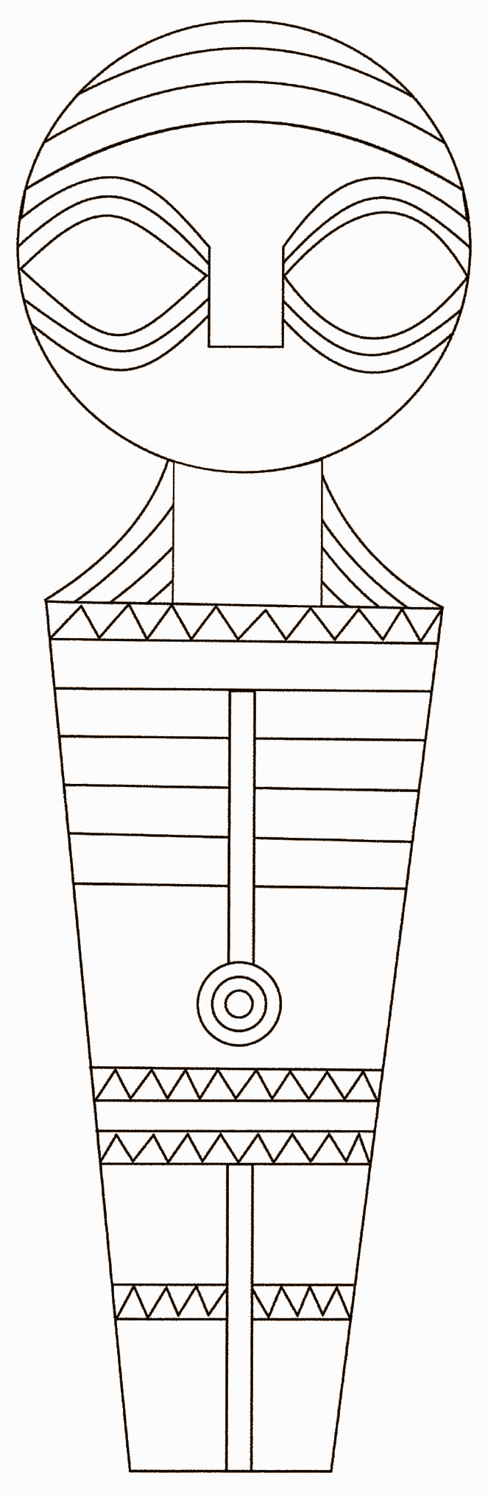
Capture/Recapture Simulation
Work with a partner
Follow the directions on the activity sheet

Slide 9

Stand Up Hand Up
Find a partner you did not work with today.
Share with your new partner, your prediction and the actual number in your sample.
Bring this information back to your original partner

Slide 10

Deer Tags, Take Two
Is the capture/recapture method you simulated today an accurate way to predict a population? Why or why not?
Notes:
Students should answer this question based on how close their prediction matched the actual number in their sample AND the new information they got from the Stand-up/Hand-up

Slide 11

Wrapping It All Up
The tribe is planning to use the capture/recapture method to determine the number of tags to issue. Write an email to Lindsay about whether you support this plan and why.

