Slide 1

Examining Data
How observant are you?
Notes:
Before teaching the lesson, please read the background notes for the teacher.

Slide 2
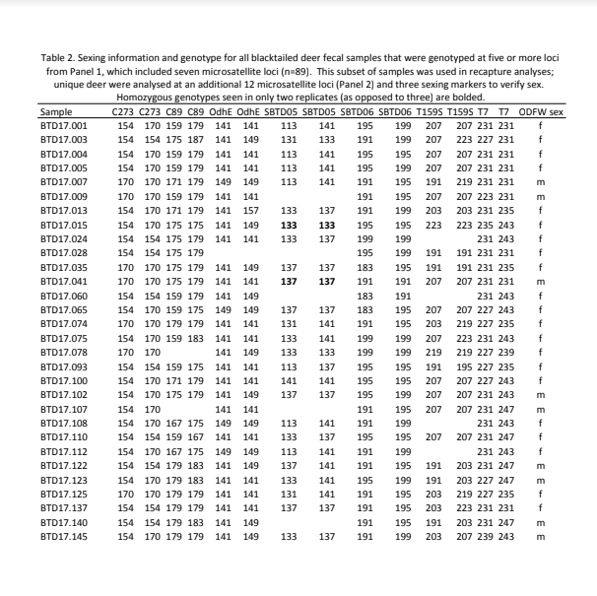
Examine the table.
What do you notice? Record your observations
What do you wonder? Record questions you have about the data
You have 5 minutes of private think time to record your ideas.
Notes:
Teacher Notes: For the first part, give students individual think time to look at the table and record observations and questions. Students may want to use highlighters to highlight important information. Students should understand that for this part they are not expected to know everything about the data - you want them to be curious about it and ask questions. Questions should be more specific than “what is this data for?”

Slide 3

What Did You Notice?
Person 1 starts by sharing what they noticed, followed by Person 2, etc...
Person 4 records the noticings for the group.
After everyone has shared what they noticed, repeat for questions. Person 3 records the questions for the group.
Notes:
In teams of 4, have students number off 1 - 4. Starting with the 1’s, each team member shares what they noticed (not the questions). The number 4 person records the collective noticings. Once sharing begins, students do not need to share something that’s already been shared - they can add anything that someone else hasn’t already said. Then, repeat for questions but Person 3 records the questions.

Slide 4

Class Noticings and Wonderings
Person 2 will share what their group noticed.
Person 1 will share questions the group has.
Notes:
Have each group share their noticings and questions. Record on chart paper or on a white board the noticings that come up and questions. For things groups noticed that may not be evident, be sure to ask what they think it may mean.

Slide 5

A Little Background...
Read your passage. Highlight important information that may answer any of the questions we have.
Do not talk about your passage with your group yet!
Notes:
There are 4 passages with different information about the data. Each person in the team will read a different paragraph.

Slide 6
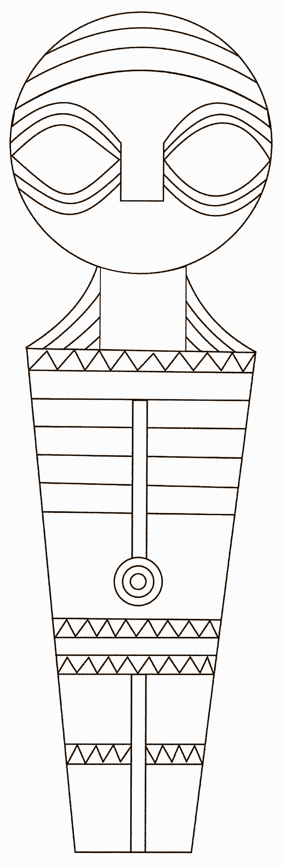
Four Corners Activity
Go to the assigned spot in the room.
Share: an important piece of information from the passage.
Discuss: Does this answer any of the questions we have?
Notes:
Use a four corners strategy so students read, discuss, and share information from their passage. Each person in the group reads a different passage. Then have students who read the same passage gather in a different corner to discuss the reading. After discussion, they go back to their original group and share the information from their passage. Students may need some prompting to begin their discussion, so pick a student to start with (student who’s birthday is the closest to today, student with the longest hair, etc…). They begin the discussion by saying something they thought was important and whether it answers a question they had.

Slide 7
4 Corners - continued
Return to your team
Each member shares what they’ve learned from their discussion.
What questions have been answered and what questions do you still have?
Notes:
During this part, circulate and listen to the information that students are sharing. After teams have had time to share, pull the class back together and have a larger discussion about which of their questions have now been answered and/or other information that should be added to the ‘noticed’ column.

Slide 8

Summarizing Your Thinking
With your team, summarize what you’ve learned on your graphic organizer.
Be prepared to share your summary with other groups!
Notes:
Who conducted this study and where was it conducted?
What will this data be used for?
How was the data collected?
When was the study conducted?

Slide 9

Additional Information?
What questions do you still have?
Notes:
At this point, teams may now ask the teacher for additional information by asking questions. See detailed notes on the data table and sample to answer questions. If students ask a question that you don’t have an answer for, let them know you don’t have the answer to that question.

Slide 10
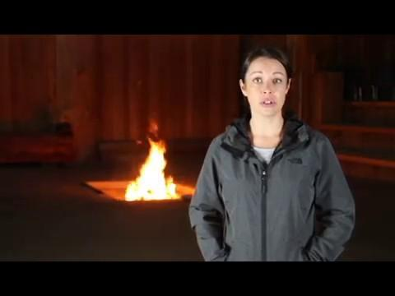
Notes:
End of day one has a video where Lindsay Belonga from Grand Ronde talks about the study and her job.

Slide 11

Summarizing Our Learning
Summarize what you know now about the data.
Notes:
Students can do this individually or as a team. The purpose is for them to process what they saw and heard today on paper and video and summarize their thinking.

