Slide 1
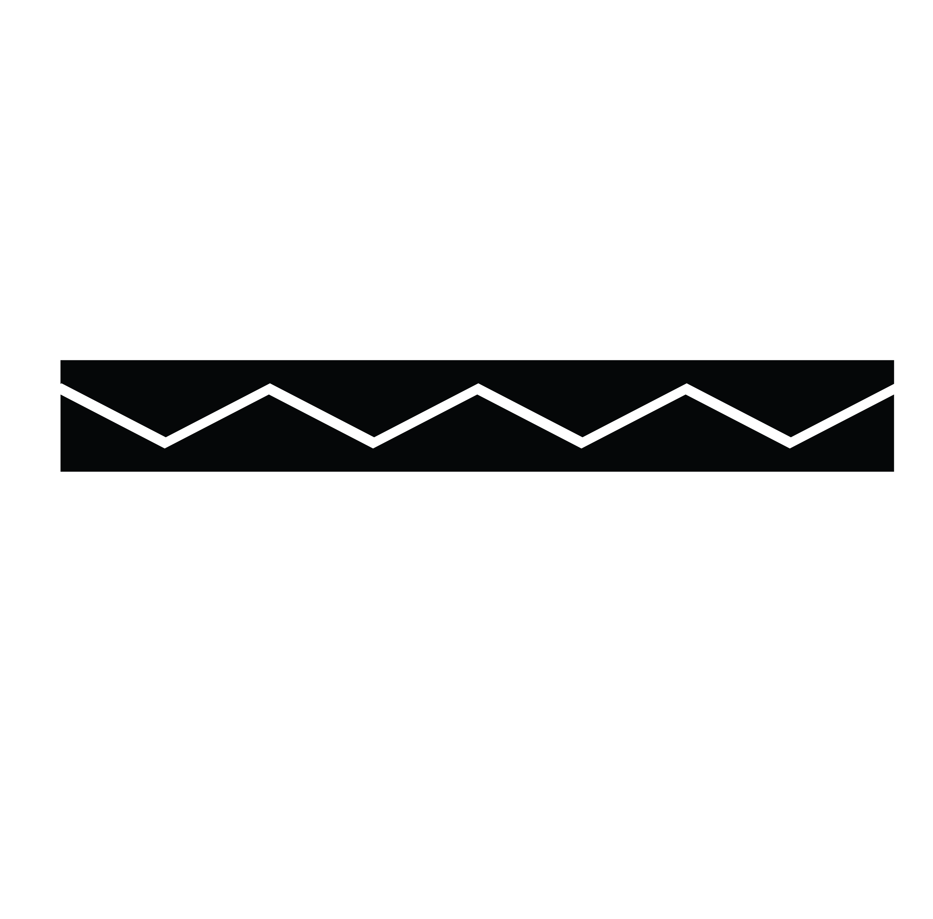
Grand Ronde Native American Artifacts
The Confederated The Tribes of Grand Ronde
The Confederated Tribes of Grand Ronde

Slide 2
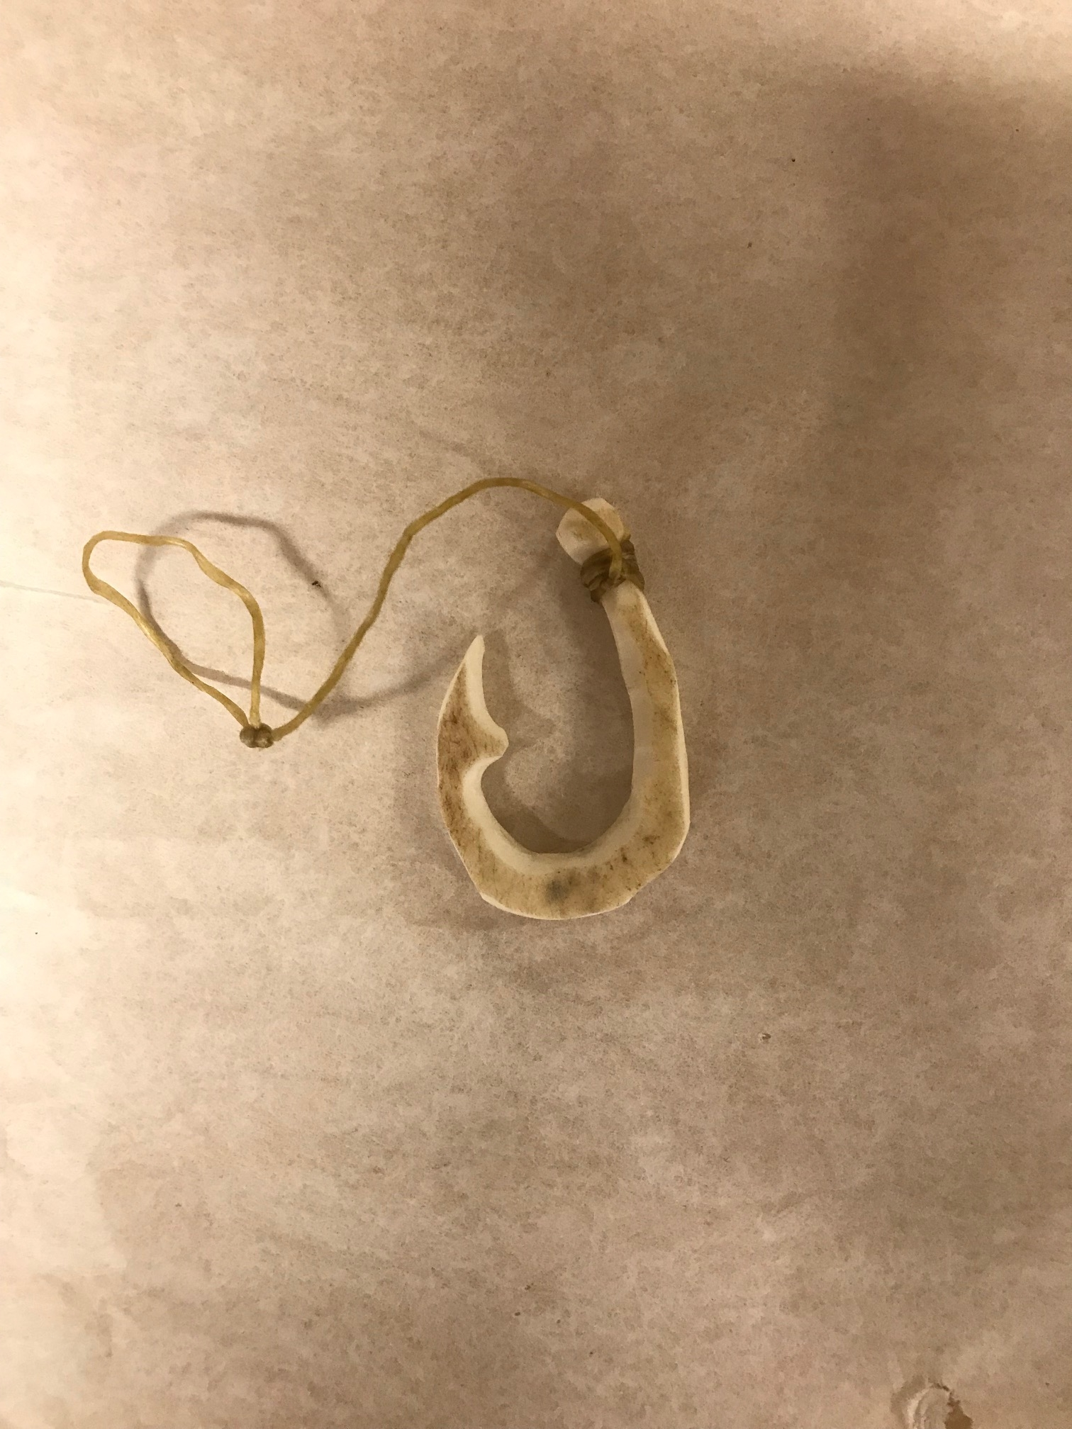
Fish
Hook
This fish hook is made from bone. The hook would have been carved from the bone of a harvested animal.

Slide 3
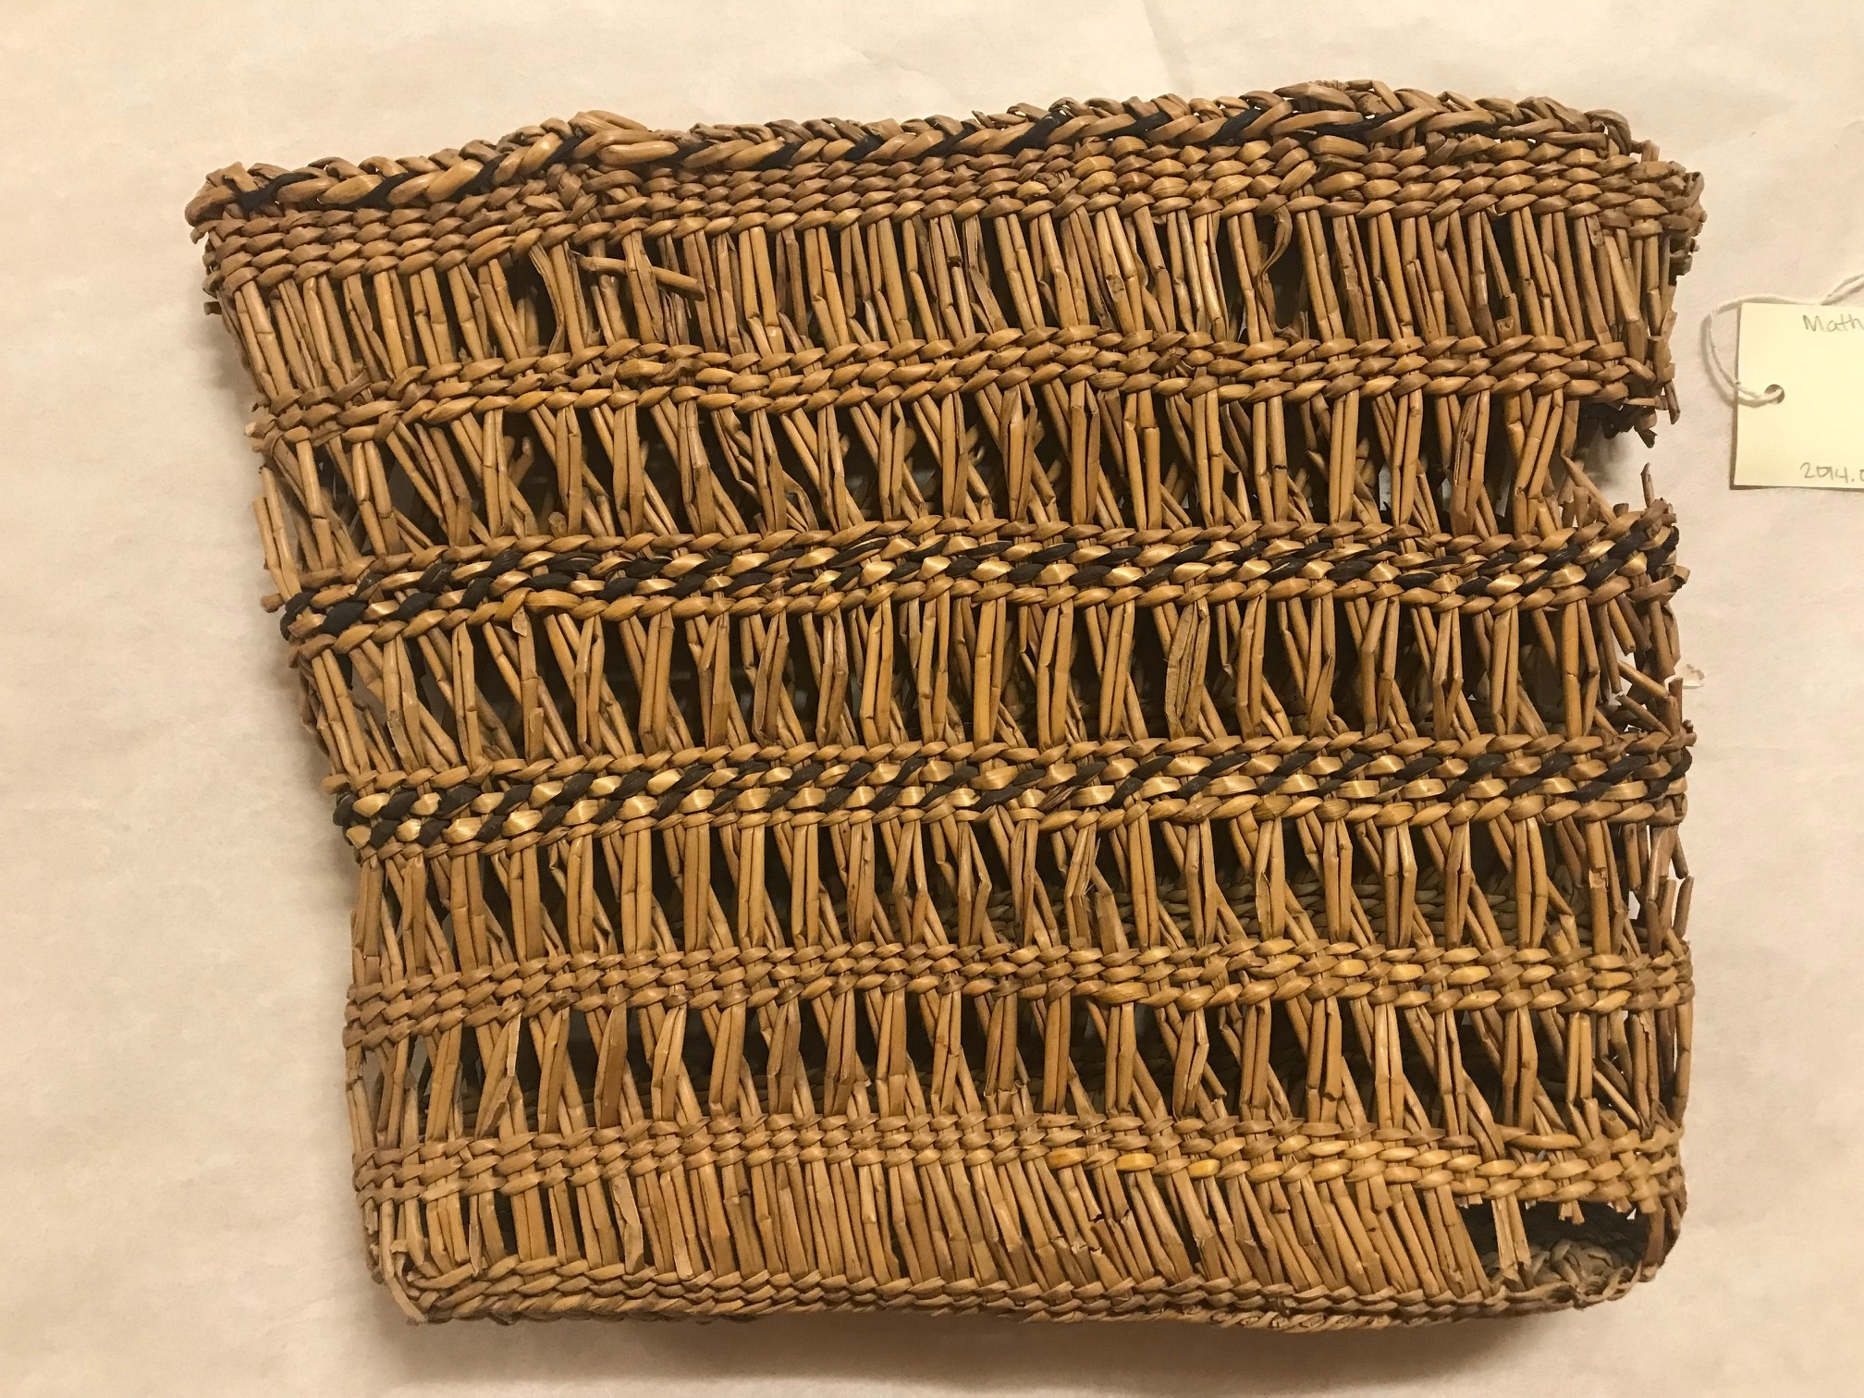
Grand Ronde Purse
This purse is made from juncus, white beargrass and black dyed maple bark.

Slide 4
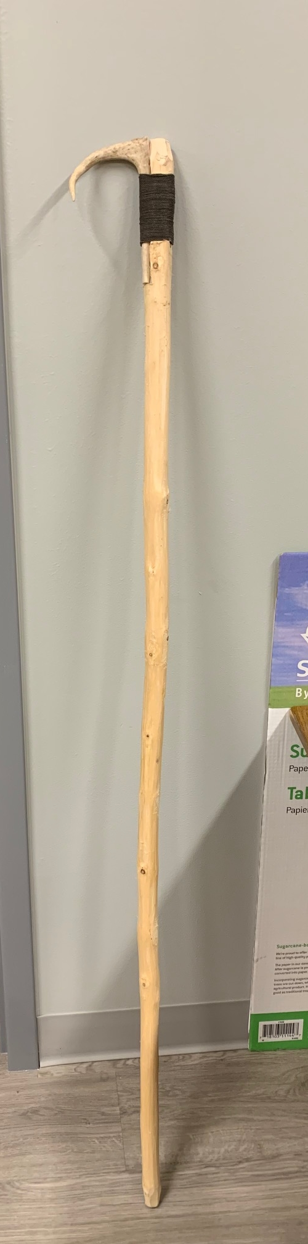
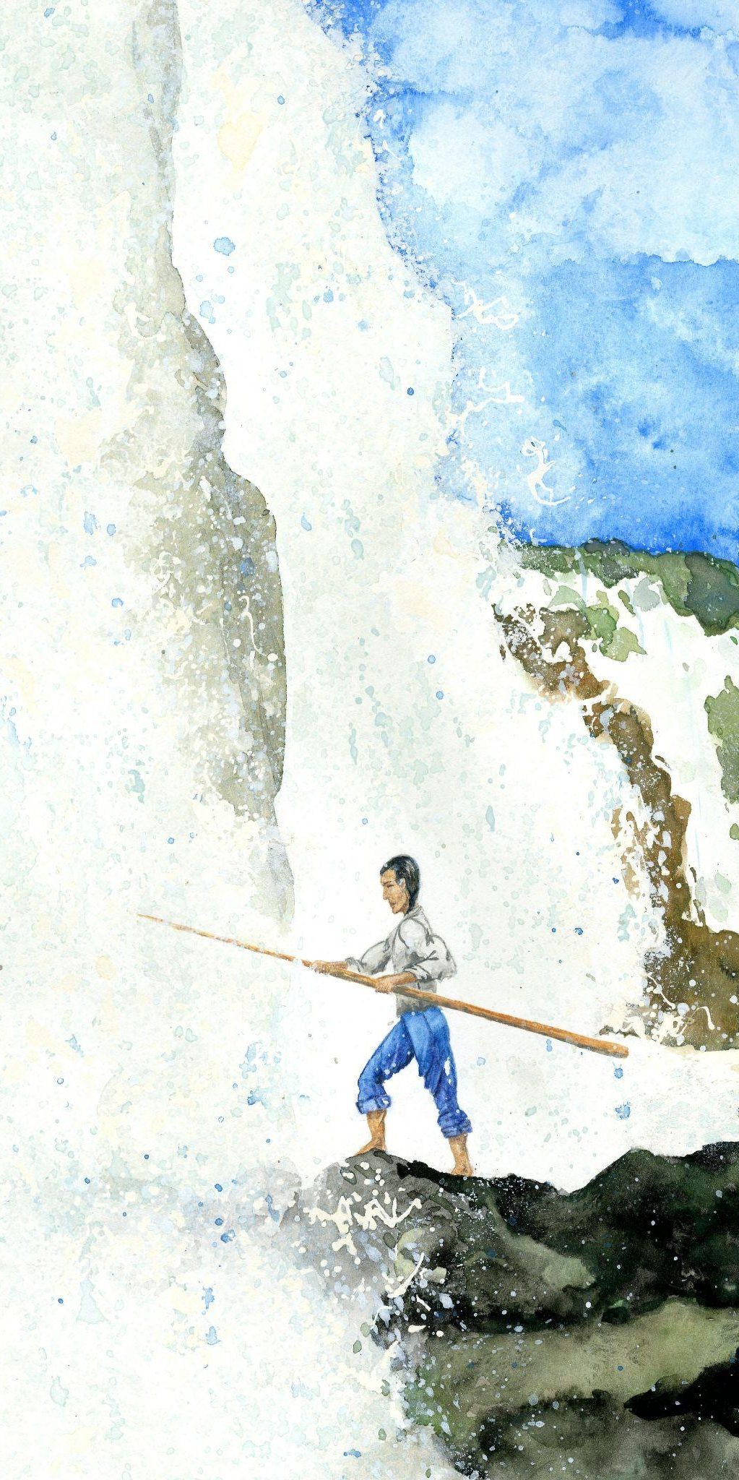
Traditional
Gaff Hook
Gaff hooks were used to fish for eel in the waterfalls. The hook is carved out of wood.

Slide 5
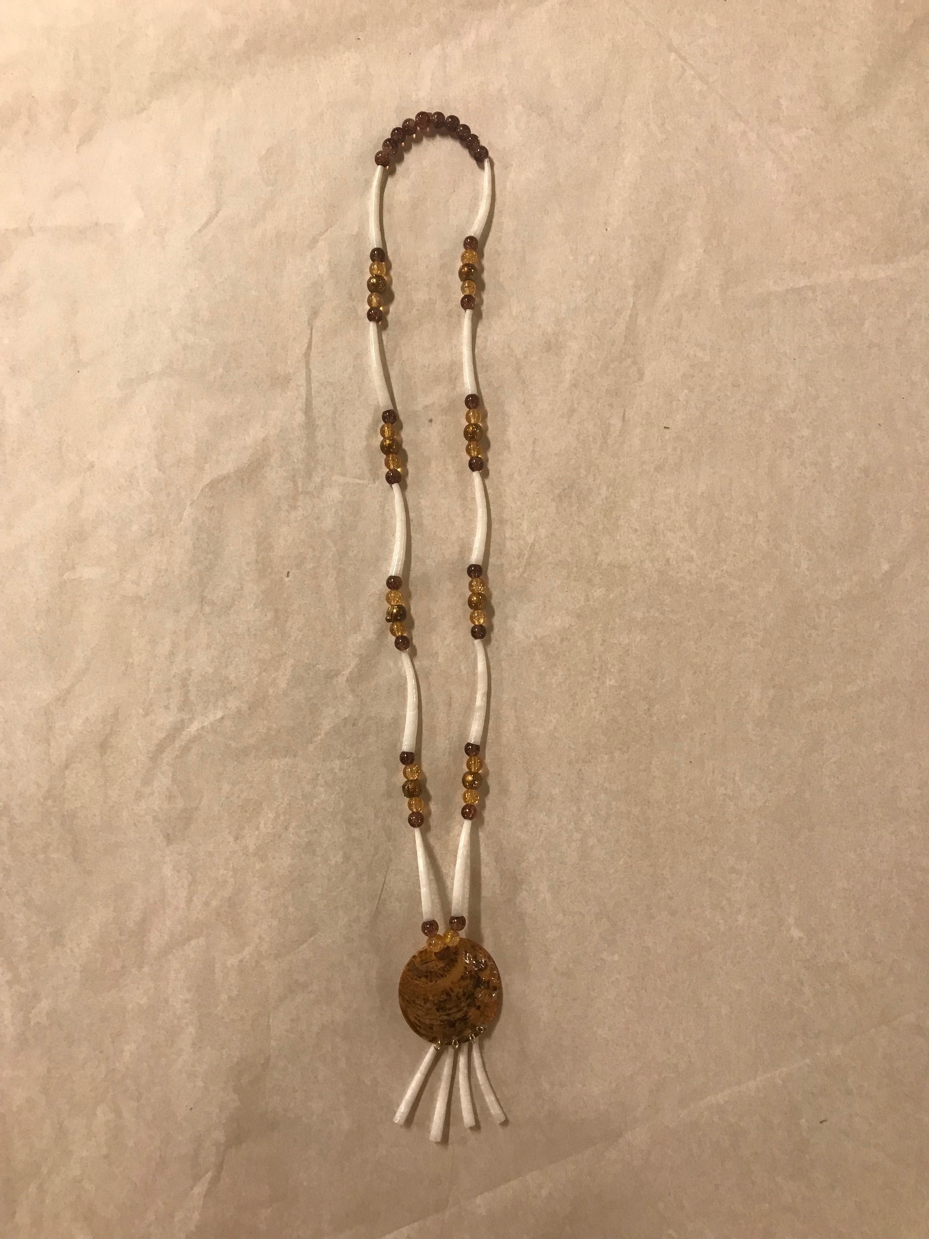
Necklace
Traditional Grand Ronde necklace that is made of beads and dentalium shells.

