Slide 1

Data Ratios
How much is enough?
Notes:
Before teaching the lesson, please read the background notes for the teacher.

Slide 2
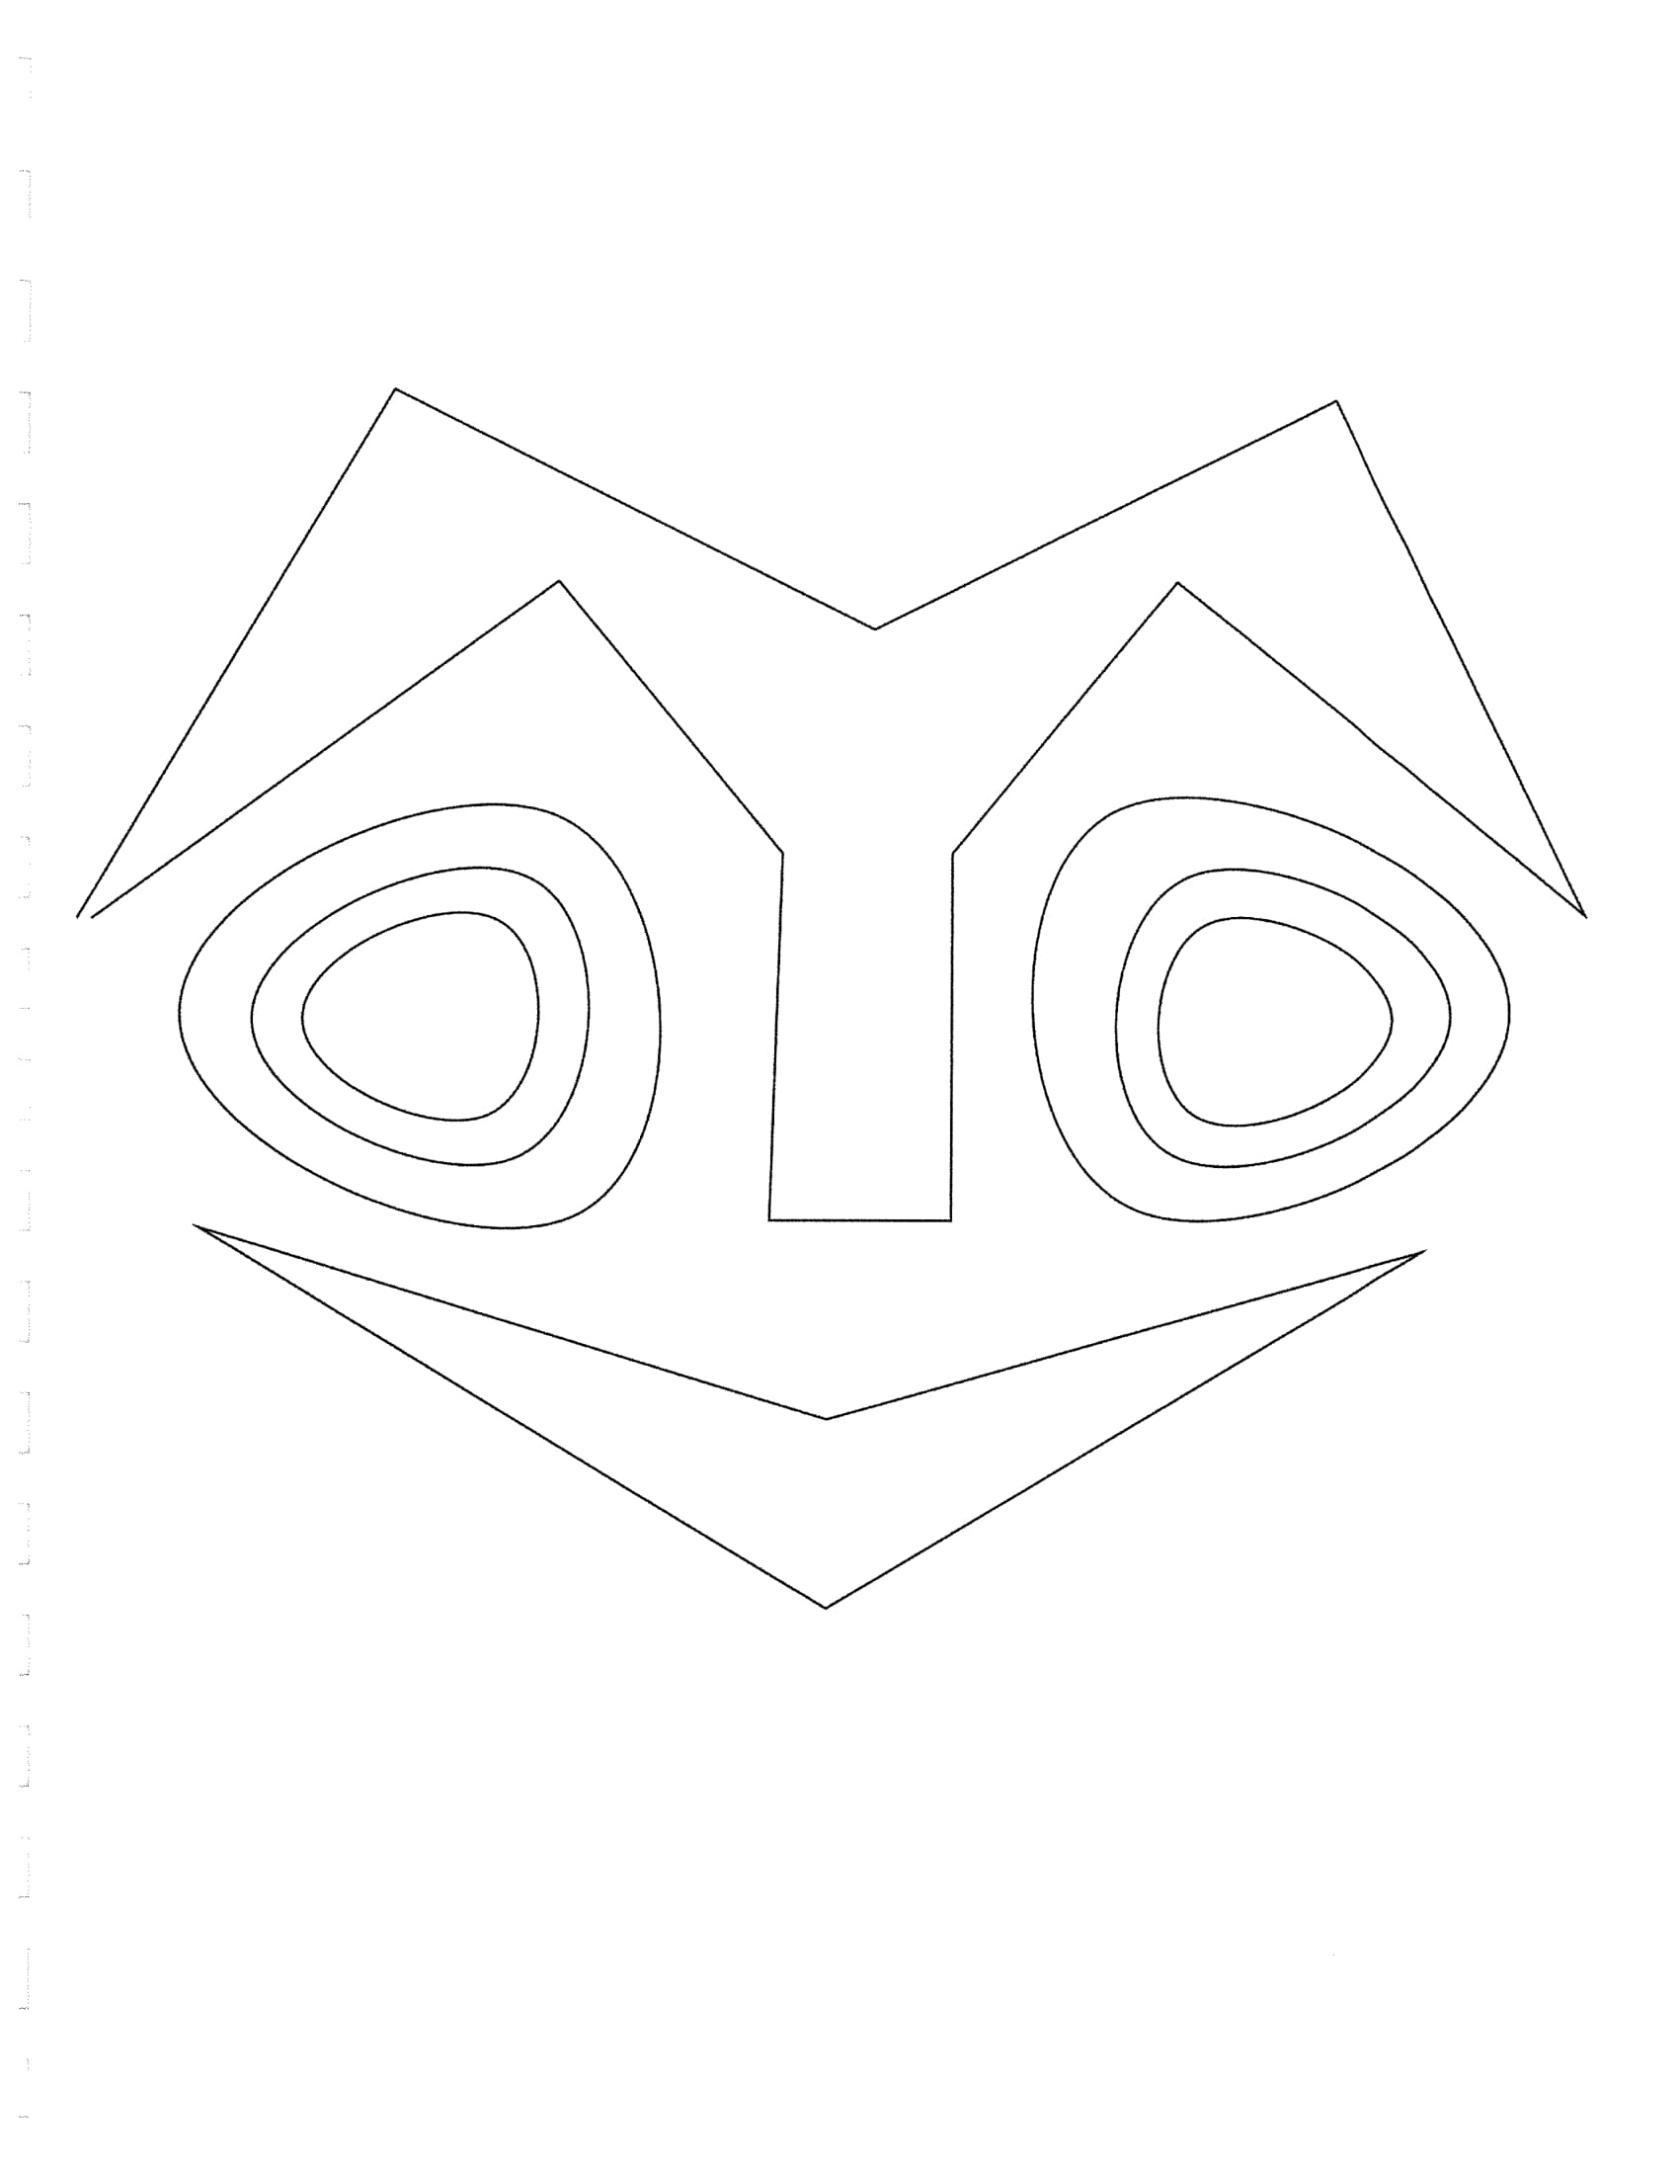
Give One, Get One
Find a partner, tell your partner one thing you remember about yesterday’s activity.

Slide 3
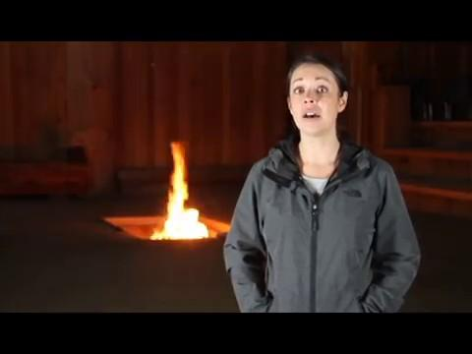

Slide 4
Using a Simulation to Make Predictions
With a partner, use the materials your teacher provides to take a sample of 7 ‘Deer’.
Record the data on your paper.
Keep the 7 and pull 14 more samples to make 21 total ‘Deer.’ Record the data. Repeat for 35.
Notes:
Each pair of students should have materials for the simulation. Make sure students record the number of Male and Female deer they pull and record it on the organizational chart provided. You will also need to collect the data for each pair of students. This can be done on a white board, doc camera, chart paper, or computer but it needs to be in a place where all students can access it and see it for a class discussion.

Slide 5
Using Data
Based on the data you collected, predict the % of Bucks and Does in your sample.

Slide 6
Class Data
Add your data to the class charts (7, 21, and 35)

Slide 7
Exit Ticket
Explain how sampling part of a population can give you information on the whole population. Make sure you summarize the mathematics used to predict information about the population.

