Slide 1
Preparing for a Journey
Travel on the Grand Ronde Trail of Tears

Slide 2
Removal & Relocation
More than 30 Tribes and Bands gathered from Western Oregon, Southwestern Washington, and Northern California were removed and relocated to the Grand Ronde Indian Reservation - creating what we now know as “The Confederated Tribes of Grand Ronde”
The most memorable of these relocations is what the Tribal community today calls “The Grand Ronde Trail of Tears.”
The Rogue River and Chasta Tribes were the first to be removed (ɬaq) from their aboriginal lands. They were joined by members of other Tribes and bands as the march passed other tribal homelands.

Slide 3
Conditions on the Trail
The weather was wet and cold
Clothing was not made to travel so many miles
There was not much food
Many people became sick and could not heal
8 people died and 8 babies were born
“It almost makes me shed tears to listen to them as they totter along”
-observed Lt. E.O.C. Ord who witnessed one of these removals.

Slide 4
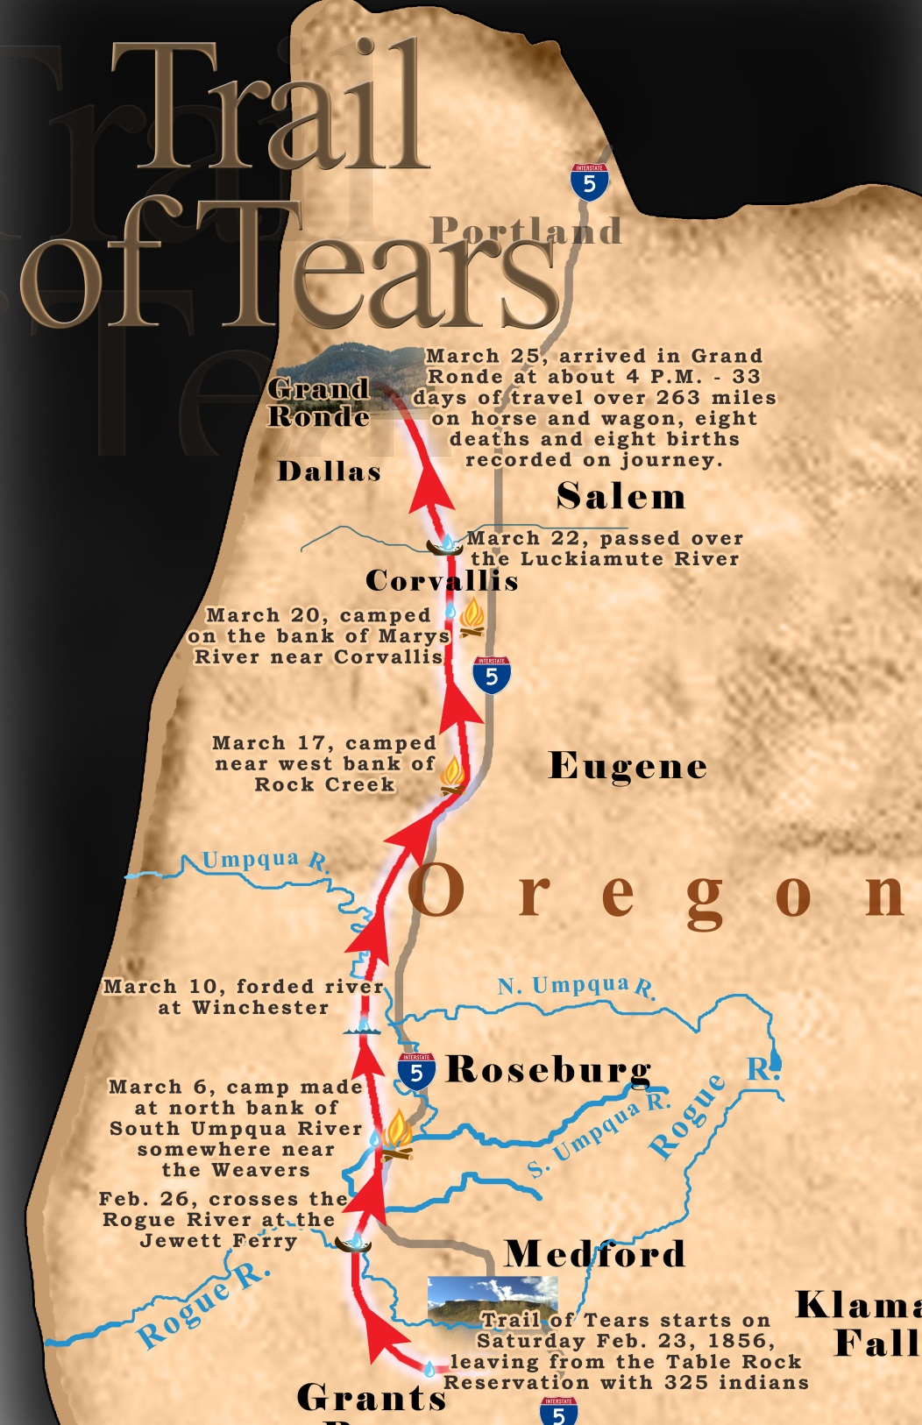
Trail Facts
February 23, 1856: 325 Native Americans left the Table Rock Reservation.
March 25, 1856: Arrived at the Grand Ronde Reservation around 4PM.
33 days (sans)
263 miles
8 deaths (chaku-hilu)
8 births (t’ɬap-tǝnas)

Slide 5
Question #1
The Grand Ronde Trail of Tears included 263 miles of travel over 33 days. If they traveled the same number of miles every day, what was the average number of miles traveled each day?
____________________ ➗ __________________ = _______________ miles
Notes:
263/33 = 8 miles (round to the nearest tenth)

Slide 6
Question #2
A rider on a horse can travel 30 miles in one day.
A person walking can travel 7.5 miles in one day.
If it takes 263 miles to travel to Grand Ronde:
Who would arrive at the Grand Ronde Reservation first?
How many days would be between their arrivals?
Notes:
The rider on a horse would arrive first
263 (total miles) / 30 (miles traveled per day by horse) = 8.8 days
263 (total miles) / 7.5 (miles traveled per day by foot) = 35.1 days
35.1-8.8 = 26.3 days would be between their arrivals

Slide 7
Question #3
In the beginning of the journey, the U.S. Government had put together 6 teams to transport the 325 "Indian Refugees". If the 325 Native Americans were divided into 6 equal teams, how many Native Americans would be supervised by each team?
Notes:
325/6 = 54.3
Explain to students that you cannot have ⅓ of a person in a group
54 (total number of whole people in a group) x 6 (total number of groups) = 324
There will be one Native American left over which means one group will need to have 55 Native Americans while the rest will have 54

Slide 8
Question #4
Later in the journey after many of the Native Americans became sick, the United States Government added two more teams to help transport the Native Americans. How many Native Americans would be in each group now?
Notes:
325/8 = 40.6
Explain to students that you cannot have 0.6 (or ⅔) of a person in a group
40 (total number of whole people in a group) x 8 (total number of groups) = 320
There will be five Native American left over which means five groups will have 321 Native Americans and three groups will have 320

Slide 9
Question #5
By February 29th, only 6 days into the journey, 2 Native Americans had died and 34 were sick. Write a fraction to show the number of healthy people that remained
Notes:
325 (total number of Native Americans) - 2 (Native Americans who died) - 34 (Native Americans who are sick) = 289
289/325 → does not reduce any lower

