Slide 1
Restoration
- restoring our status and our tilixum -
Notes:
tilixum: chinuk wawa for “people”

Slide 2

Restoring a People
Notes:
https://www.facebook.com/watch/?v=1112471305834681

Slide 3
Background
On August 13, 1954 - Public Law 588, Western Oregon Indian Termination Act was signed into law by President Dwight D. Eisenhower.
This act terminated the Tribes’ federal recognition and removed all agreements that had been negotiated through treaties between the United States government and the Confederated Tribes of Grand Ronde.
63 tribes total were terminated in Oregon. More tribes were terminated in Western Oregon than any other region of the U.S.

Slide 4
The Effects of Termination
What happened after The Western Oregon Termination Act was signed into law?
The Tribe lost all its treaty rights and land (iliʔi)
The Reservation was closed in 1956 and services were withdrawn.
Tribal members scattered throughout the country
Some Tribal members remained in the area but life was extremely difficult
Terminated Indians were like new immigrants to America - with no resources, no savings, and little help from the government. Grand Ronde lands were sold, the average payout was $35 per person.
Most Tribal members were forced to relinquish their allotments lands (property) as they did not have the funds to buy them from the government. Some tribal members were able to purchase their property and stay in Grand Ronde.
Along with the termination of treaty rights Native peoples also lost:
  A sense of identity
  Pride in their history
  Cultural practices and traditions
  Their homelands
Notes:
Iliʔi - chinuk wawa for land

Slide 5
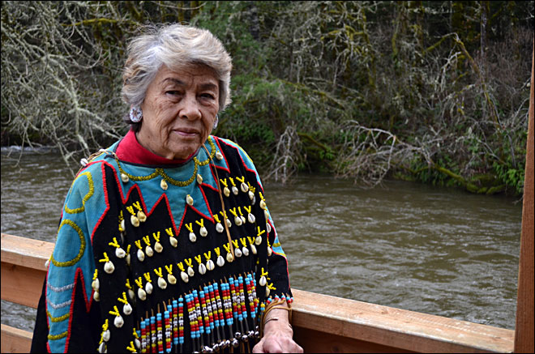
“It changed our lives. Things weren’t the same after that.”
“At the stroke of a pen they wiped us away.”
Margaret Provost, Grand Ronde Tribal Elder

Slide 6
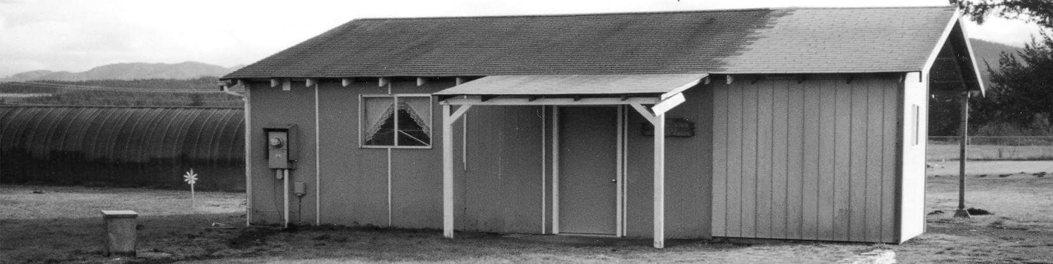
Creating A New Beginning
In 1972, tribal elders Margaret Provost, Marvin Kimsey, Merle Holmes, and others began organizing the tribe for restoration. These three individuals are often called the “Visionaries”
Through fundraising efforts, they were able to gather enough money to travel, pay postage, and spread knowledge about the importance of restoration. They had to educate the community, the county, and the state of Oregon.
In order to get termination overturned, they must convince U.S. Congress that they had made a mistake in terminating the Tribe.
Knowing that they would need support from outside sources, they worked to ally with Oregon Senator Mark O. Hatfield, Representative Les AuCoin, and Governor Victor Atiyeh and lawyer Elizabeth Furse, who directed the Restoration Project of the Native American Program of Oregon Legal Services (NAPOLS).
These outside resources assisted in the restoration process knowing that supporting the efforts for restoration was the best thing they could do to help solve the tribe’s many problems with health issues, poverty, and cultural loss.

Slide 7
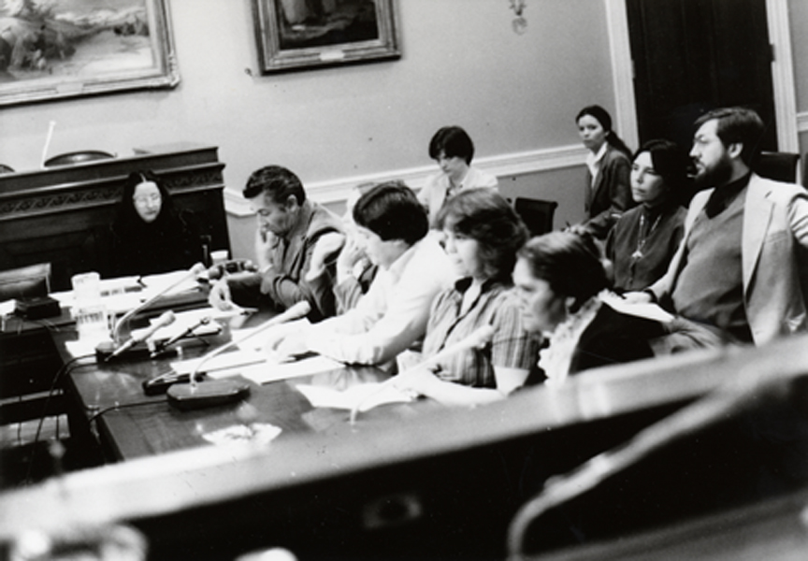
Testimony
“All we want is our piece of pie back. When we got terminated, your piece of the pie got bigger. All we want is our piece of the pie back.” -Kathryn Harrison
October 1983 -
Marvin Kimsey, Jackie Whistler, Kathryn Harrison, Frank Harrison, and Karen Harrison travelled to Washington D.C. to testify in front of the House of Representatives
When they testified, they focused on the issue of justice. They explained their desire to become part of Indian Nation once again.
Despite oppositional pressure from the regional fishing and hunting lobbies, Congress passed the Grand Ronde Restoration Act (25 U.S.C. 713 et seq.)

Slide 8
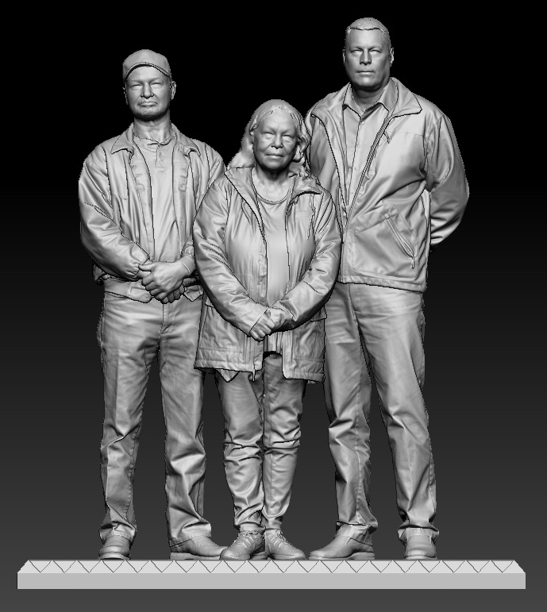
The Grand Ronde Restoration Act
President Ronald Reagan signed the bill into law on November 22, 1983.
The people of the Confederated Tribes of Grand Ronde gathered at the cemetery building to celebrate. They knew the work of this process was over but there was still hard work to come. They must rebuild a nation.

Slide 9
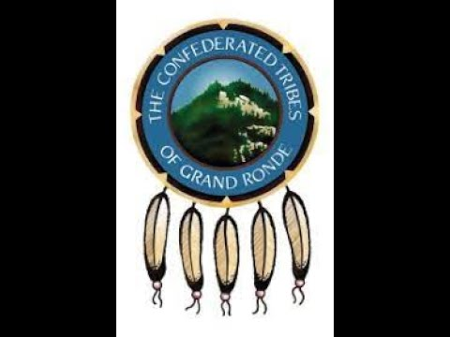
Post-Restoration
1988 - President Reagan signs the Grand Ronde Reservation Act into law which returned nearly 10,000 acres of the Tribe’s original reservation land
1989 - Tribe purchased 5.5 acres and began to build the Tribal Community Center, the first permanent building
1994 - Tribal membership voted to pursue gaming as a revenue source
1995 - Spirit Mountain Casino opens
With the availability of funds from the Casino, the Tribe was able to begins to focus on member services and growth
1996 - Tribal Housing and Timber Trust Fund
1997 - Health and Wellness, Grand Meadows, Spirit Mountain Community Fund
1998 - Governance Center Opened
2000 - Elder’s Housing, Education Complex
2002 - Education Complex
Notes:
Video in top right corner is a piece of the Grand Ronde Restoration video (also found on slide #11), but summarizes these events
Take a virtual tour of the Grand Ronde campus today : https://roundme.com/tour/433498/view/1480429/

Slide 10
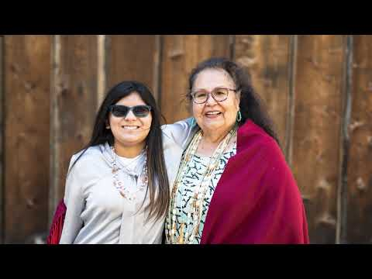
Restoration Celebrations
Today, the Confederated Tribes of Grand Ronde celebrated Restoration Day on November 22nd each year.
They celebrate by gathering together, enjoying a meal, and giving back to their membership through monetary or prize gifts.
They focus on honoring their ancestors who sacrificed tremendously, the leaders who fought for them to be here, and those who will take them into the future.
Restoration Celebration Year 38 - Slideshow

Slide 11
Notes:
Grand Ronde Restoration Video:
Hear the voices of those who lived through the Termination, Restoration, and Post-Restoration Eras

