Slide 1
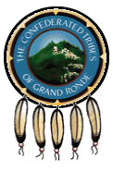
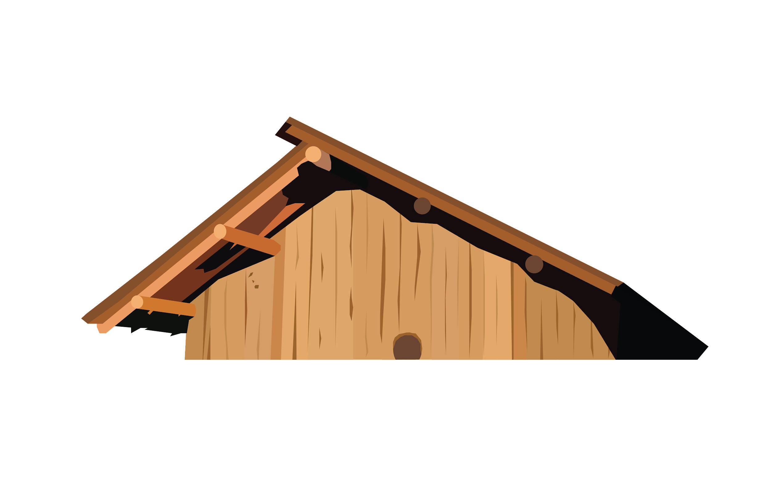
We Are
Grand Ronde
Ntsayka Ikanum – Our Story

Slide 2

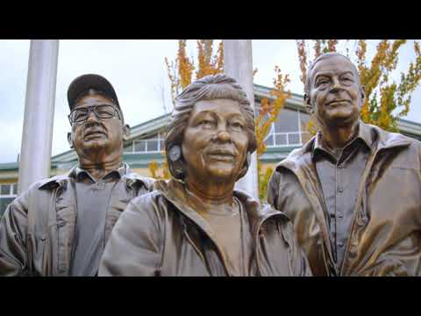
Our Story
The Grand Ronde Tribe's story is one of persistence and perseverance.
Notes:
For additional videos, visit the Confederated Tribes of Grand Ronde YouTube page
https://www.youtube.com/channel/UCFZ3ni-tJnLlBBC9TEPSdCg/videos

Slide 3

Vocabulary
Indigenous Peoples: Descendants of those who originally inhabited a country or region prior to colonization. It can refer to any indigenous peoples around the world - (Maori of New Zealand, the Confederated Tribes of Grand Ronde in the United States, the Maya in Guatemala, the Aborigines and Torres Strait Islanders of Australia, and the Saami of northern Europe, etc.)
Native American/American Indian: descents of those who originally inhabited the United States of America prior to colonization (The Indigenous Peoples of the United States)
Tribe: A group of indigenous people that share similar cultural, social, political and/or economic characteristics.
Band: A group of native people joined in a common purpose; to unite as a group – the band is usually a smaller part of a tribe.
Colonization: the process of settling among and taking control over the indigenous people of an area.

Slide 4
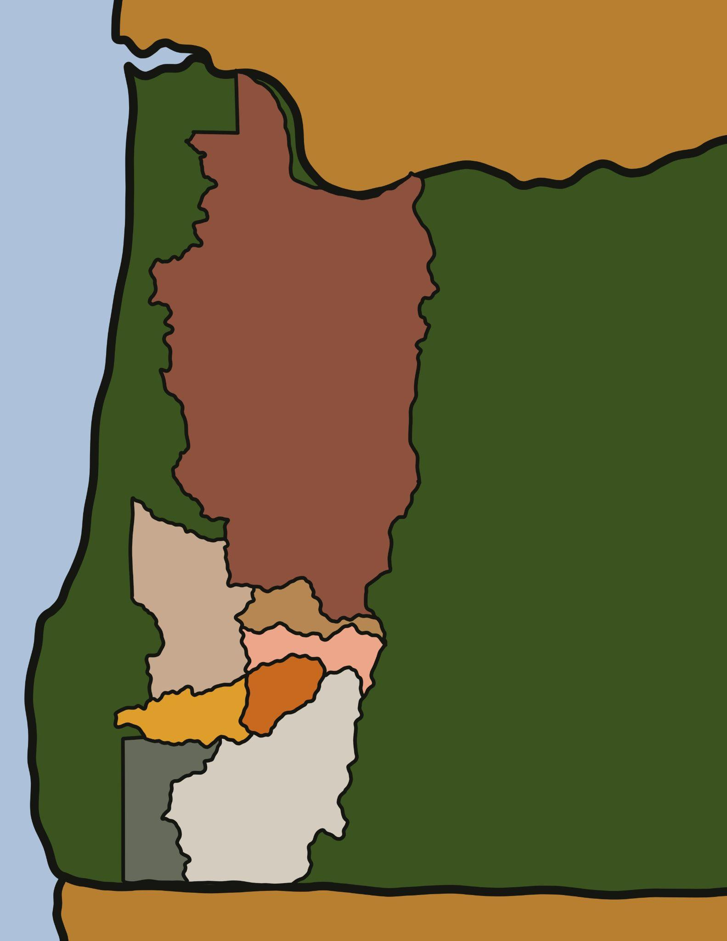
Who are the Confederated Tribes of Grand Ronde?
The Confederated Tribes of Grand Ronde is a group of 30+ tribes and bands gathered from Western Oregon, Southwestern Washington, and Northern California
These tribes and bands were removed from their homelands and were relocated to the Grand Ronde Reservation after signing 7 treaties from 1853-1855.

Slide 5
Time Immemorial
Time Immemorial: used to refer to a point of time in the past that was so long ago that people have no knowledge or memory of it
- The Confederated Tribes of Grand Ronde has existed since time immemorial.
- Some oral traditions/stories date back to 14,500 years ago
- Archaeological records (artifacts and nature recordings) date back to 14,300 years ago
Oral Traditions
Time Immemorial
Archaeological Records
Notes:
*Teacher Note: Have student(s) mark the timeline with these dates using a sticky note

Slide 6

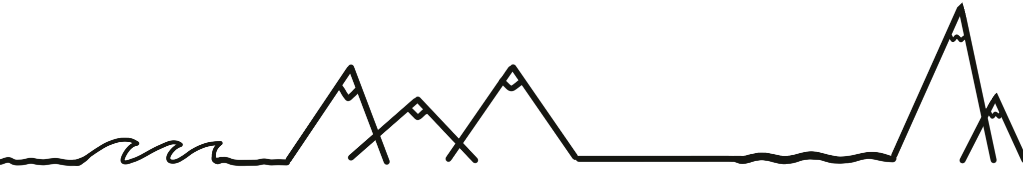
Original Tribal Areas
There were 5 main regions that the Tribes and Bands came from:
Columbia River
Willamette Valley & Coast
Umpqua Basin
Rogue Valley
The Cascade Mountains
What region of Oregon do you live in or near?
Notes:
It may be valuable to have a map of Oregon in the classroom to demonstrate to students where each of these regions lie within the state and where they live within the state

Slide 7

Traditional Lifeways
Before colonization and the removal from their homelands, the members of the Tribes and Bands lived off the land-
Fishing
Hunting
Planting & Gathering
Trade (with Natives and non-Native)
Do you participate in any of these traditional practices?
Notes:
Many members of the Confederated Tribes of Grand Ronde still participate in these traditional lifeway practices today

Slide 8
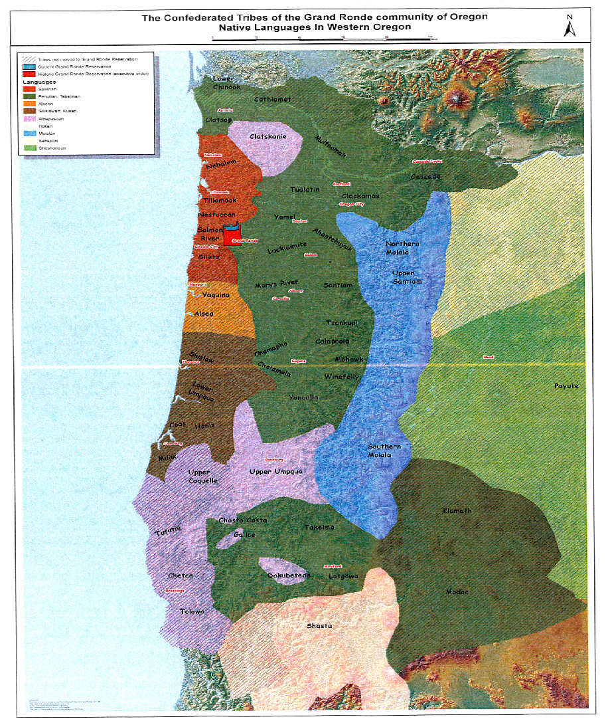
Language - lalang
Pre-Colonization there were over 100 native language spoken throughout Oregon
Many of the languages were similar - helping the members of different tribes and bands communicate with each other
What are other ways these people could communicate without speaking the same language?
Notes:
Chinuk Words:
language - lalang or wawa
There is a larger, clear version of this map in an 8 ½ x 11 PDF available as an attachment to this lesson

Slide 9
European Contact
The first non-native explorers and traders arrived here in the mid to late 1700s by ship.
They were quickly followed by the Lewis and Clark Expedition in 1805
In 1812, the Hudson Bay Company brought European goods, people from other Tribes, and traders (mukuk-man●^{r}).
European contact created many conflicts - including language (lalang)barriers, low resistance to disease (skukéúm●^{r}), land (iliʔi) takeover, value differences, food (mǝk^{h}mǝk) loss, and dependency on European goods.
Marriage to traders also became a common practice for Native American women
Oral Traditions
late 1700s
1805
1812
Time Immemorial
Archaeological Records
Explorers
Arrive
Lewis
&
Clark
Hudson
Bay Co.
Notes:
Chinuk Words:
trader (man who trades goods) - mukuk-man●^{r}
language - lalang
disease - skukéúm●^{r}
land - iliʔi
food - mǝk^{h}mǝk
This can be added to the timeline. Have students write down the event and year on a sticky note or label & place on timeline.

Slide 10
Compare & Contrast
Lewis & Clark Expedition - 1805
American led expedition
First contact with Native people of Western Oregon
Funded by the U.S. Government.
Established Ft. Clatsop on the Columbia River.
Interacted with Chinookan people up and down the river
Hudson Bay Company - 1812
British-led expedition
Hudson Bay Co. began establishing itself on the Columbia River in 1812 with the seizure of Ft. Clatsop.
Ft. Vancouver was established in the 1820s and served as a center for western fur trade and a port of colonization.
Oral Traditions
late 1700s
1805
1812
1820
Time Immemorial
Archaeological Records
Explorers
Arrive
Lewis
&
Clark
Hudson
Bay Co.
Ft. Vancouver
Established
Notes:
Explain to students how this was the beginning of colonization: Both the Americans from the Eastern U.S. and the British were fighting to colonize (or take-over) the Western U.S. from the Native Americans

Slide 11

Diseases Take-Over
Native Americans had never been exposed to the diseases brought by the early explorers, trappers, missionaries, and settlers.
Some of the most deadly diseases were smallpox, influenza, and malaria.
Sadly, neither Western nor Native medicinal practices could stop the devastation.
Massive population loss occurred – it has been estimated that over 97% of some Native populations were lost
Notes:
If possible/interested - this could be an area to discuss preventative measure that have been put in place to prevent this from happening again (vaccines). Due to the COVID-19 pandemic, we understand that this may not be a concept that all schools, teachers, parents, and students may be comfortable discussing.

Slide 12
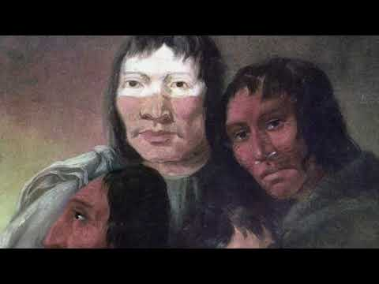
Home
Once home to the Charcowah village of the Clowewalla (Willamette band of Tumwaters) and the Kosh-huk-shix Village of Clackamas people, the area is part of the lands ceded to the United States Government under the Willamette Valley Treaty of 1855. Following the Willamette Valley Treaty, tribal members were forcibly removed from Willamette Falls and relocated to Grand Ronde.
Notes:
https://youtu.be/-K3sihHVPVY

Slide 13
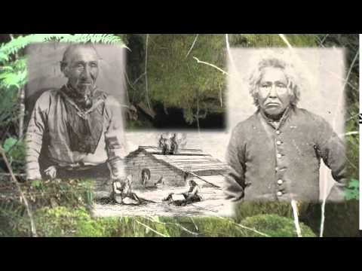
Standing Strong: Western Oregon Tribes Video
Notes:
The video will end at the 7 min. 36 sec. mark. If you would like to view the entire video, the link can be found below:
https://youtu.be/-43tfBzWfDE

