Slide 1
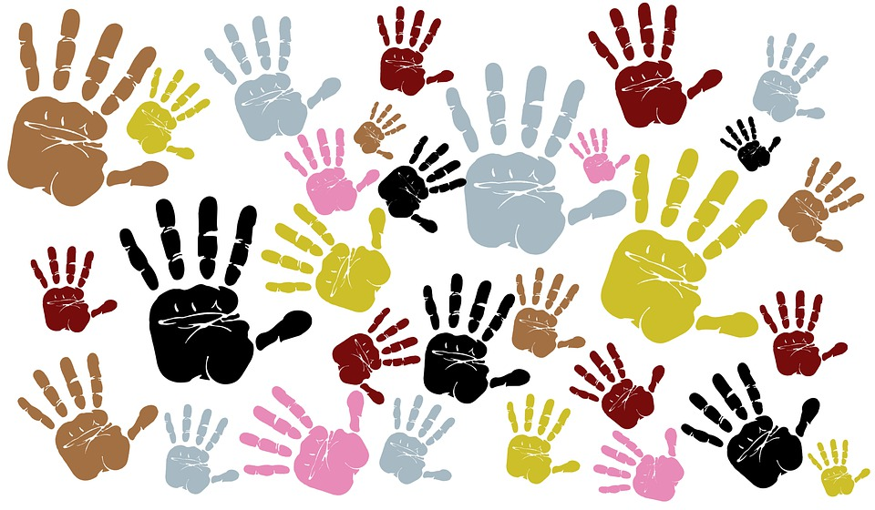
Culture

Slide 2
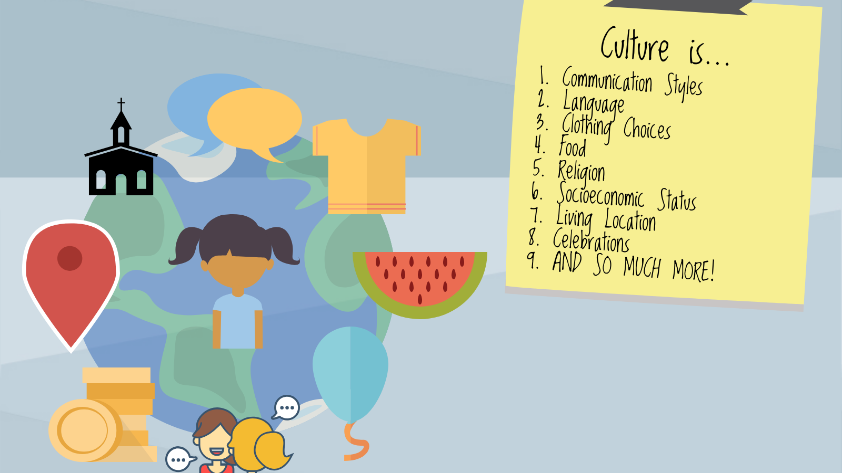

Slide 3
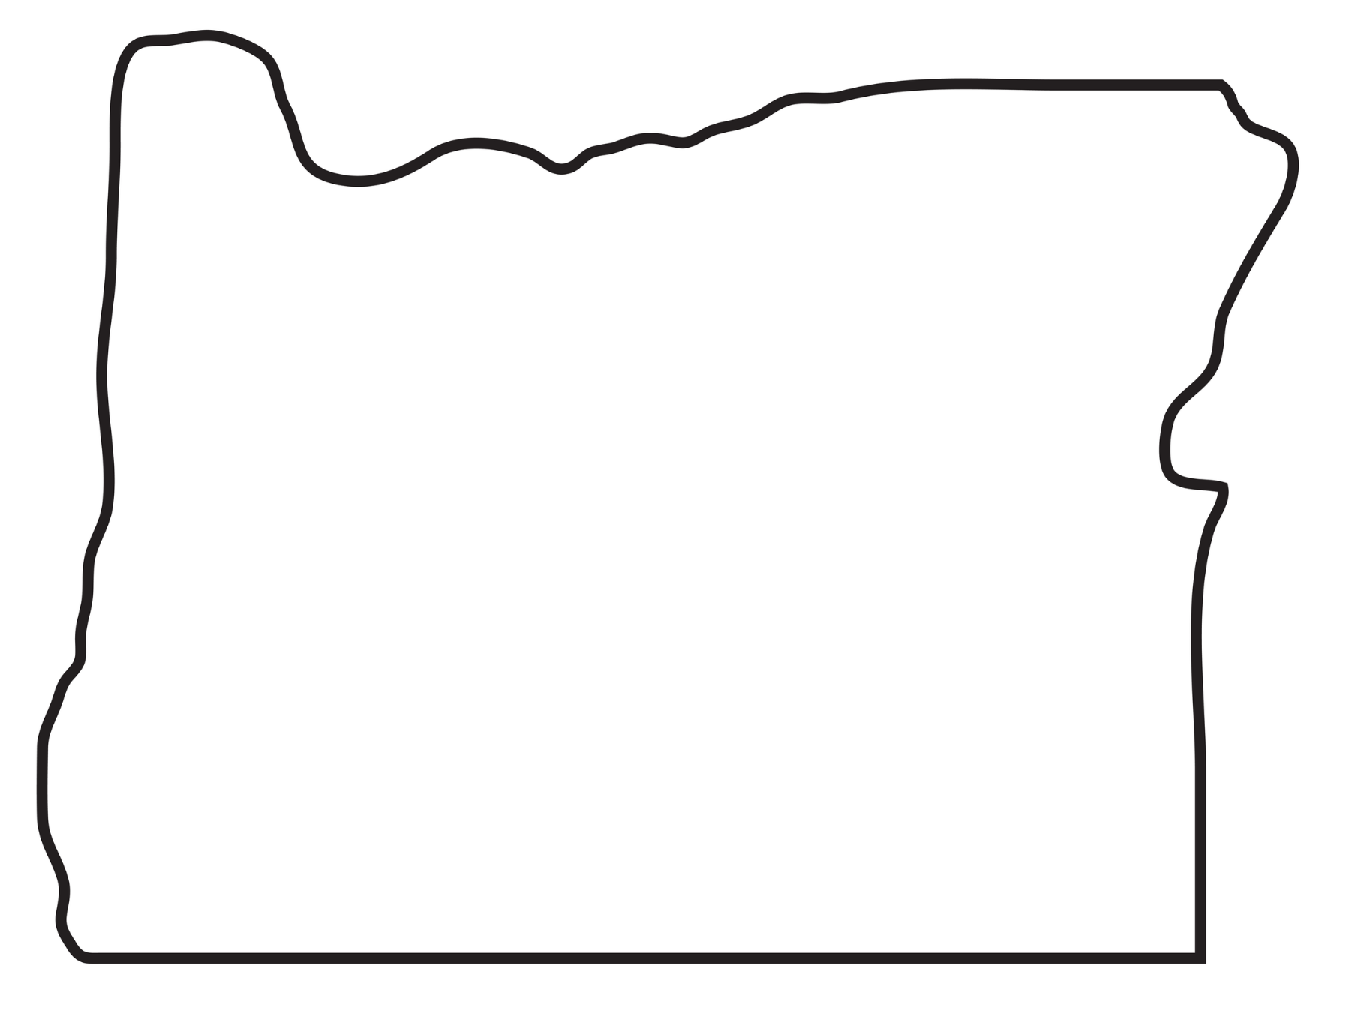
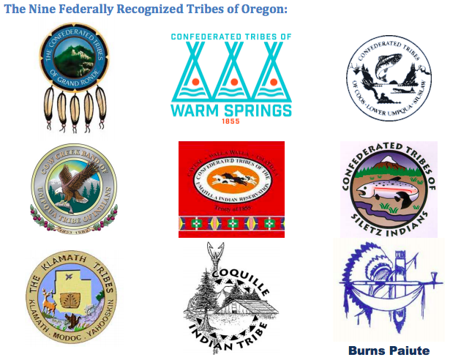
Native American Cultures
In Oregon, there are 9 federally recognized Native American Tribes.
These tribes have many members who work to honor and keep their cultures alive.
Notes:
*Remind students that the video they watched comes from one of these tribes, The Confederated Tribes of Grand Ronde. Show them the Grand Ronde logo (top left)

Slide 4
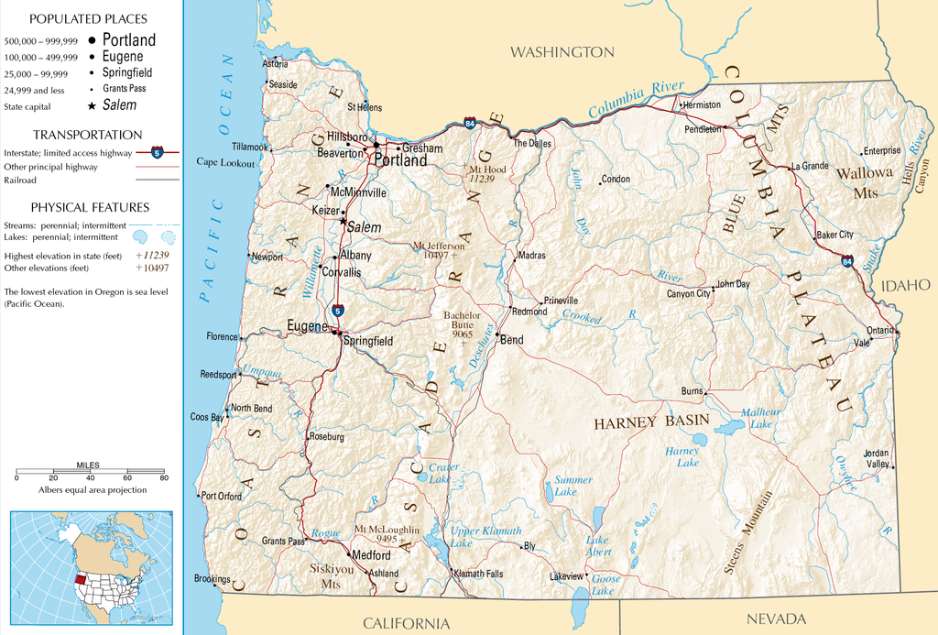
LOCATION
The Confederated Tribes of Grand Ronde
Your Culture
Notes:
The Confederated Tribes of Grand Ronde is located between the Willamette Valley and the Oregon Coast. Many members of the Tribe live on the Grand Ronde Reservation but members of the Grand Ronde tribe live all over the world!
*Help students mark where they live on the map (teachers may need to enlarge the map)

Slide 5
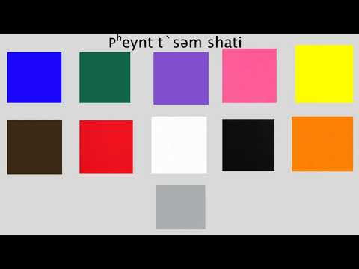
LANGUAGE
The Confederated Tribes of Grand Ronde
Your Culture
Notes:
The traditional language for the Confederated Tribes of Grand Ronde is chinuk wawa. This language is not spoken by every member of the tribe but more and more people are learning how to speak it every day! Most members of the Tribe speak English also. (Play short video - allowing students to hear the chinuk wawa language being spoken. The video is naming all of the colors shown.)
*Discuss with students what languages they speak. Add these languages to the “Your Culture” side

Slide 6
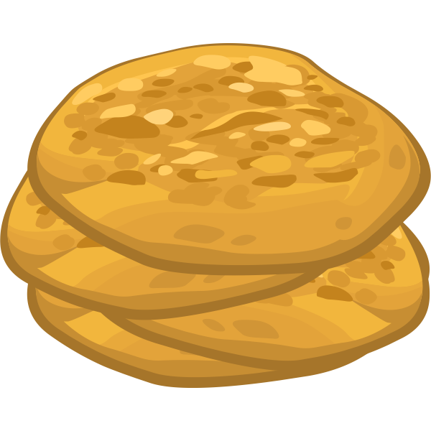
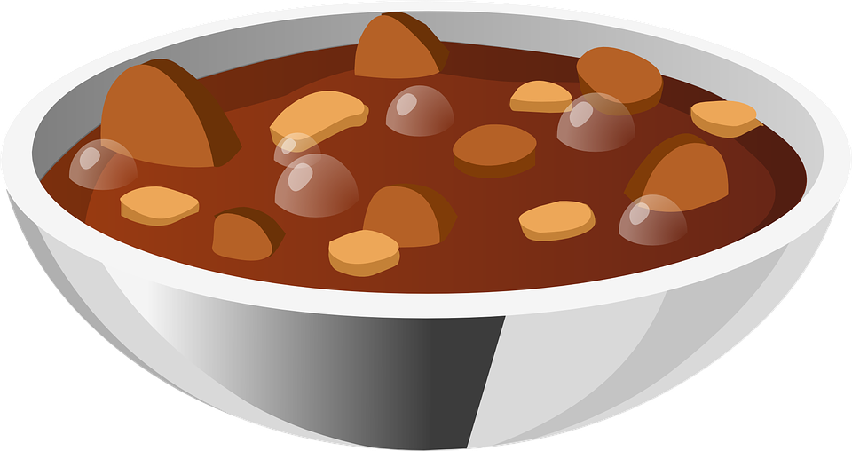
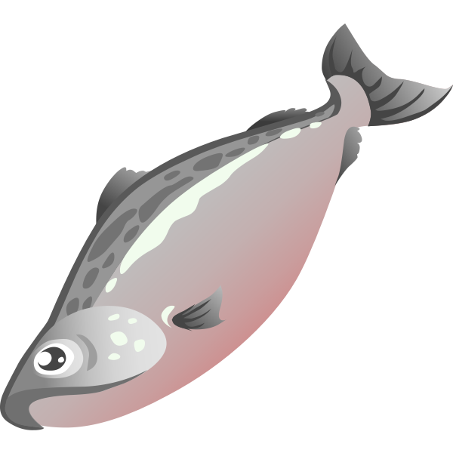

FOOD
The Confederated Tribes of Grand Ronde
Your Culture
Notes:
The people of the Confederated Tribes of Grand Ronde eat many special foods that have been important pieces of their diets for many years. While they also eat many of the same foods you do, these foods are important to their culture and recipes are passed down through generations.
Top Left: Fry Bread
Top RIght: Deer/Elk Stew
Bottom Left: Berries
Bottom Right: Fish/Salmon
*Discuss with students what foods they eat often with their families or during special times. Add these to the “Your Culture” section

Slide 7
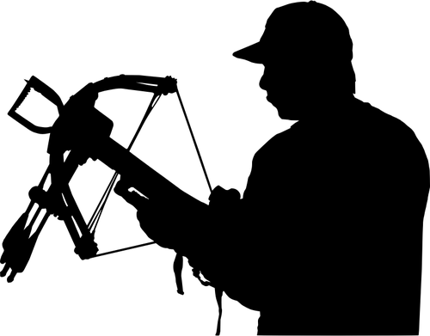
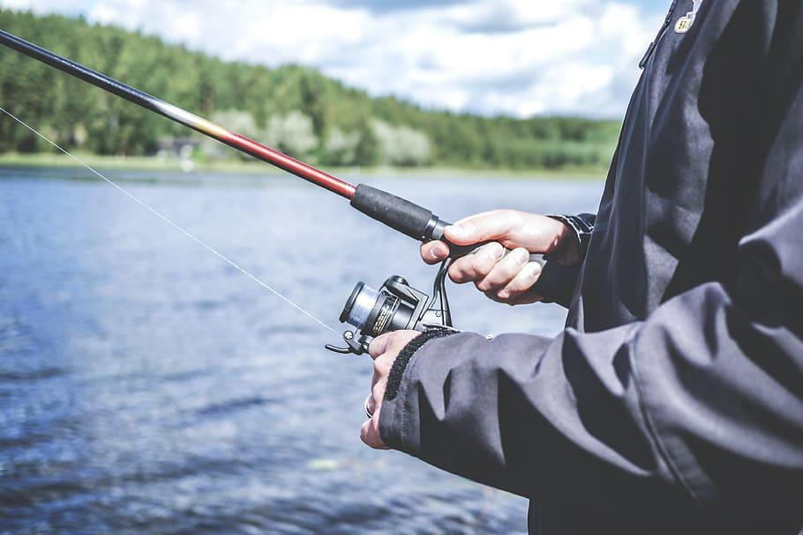
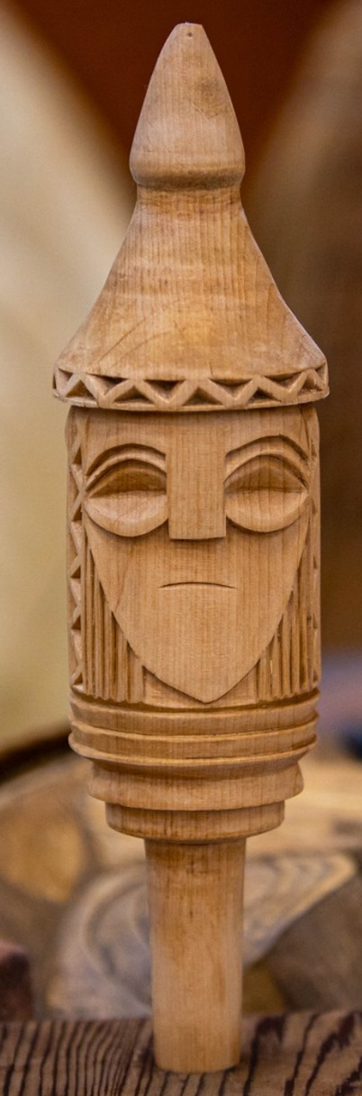
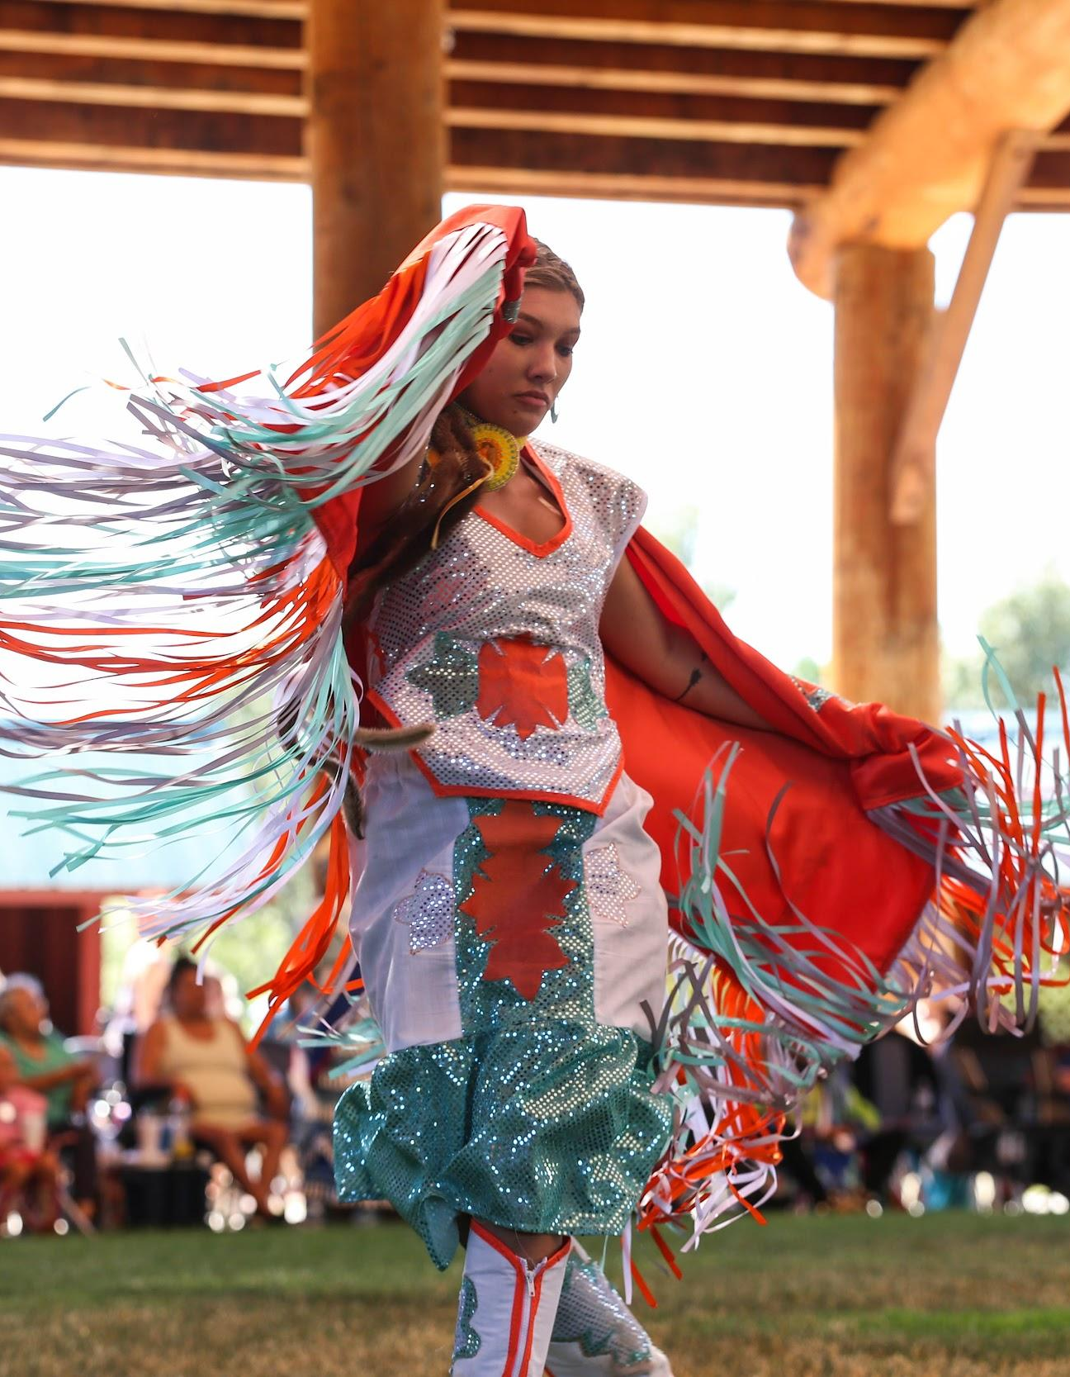
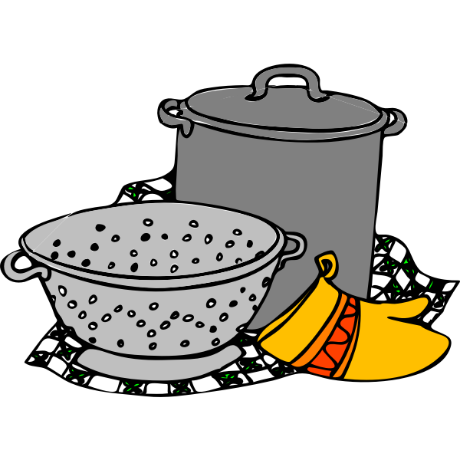
ACTIVITIES
The Confederated Tribes of Grand Ronde
Your Culture
Notes:
The people of the Confederated Tribes of Grand Ronde participate in many different activities to keep their culture strong. Many of these activities are done with their families and often times the elders will teach the younger family members how to do these activities.
*Hunting, Fishing, Dancing, Carving, & Cooking (there are many more as well)
*What activities to students do with their families? Has an elder in their lives taught them something? Add these to the “Your Culture” side

Slide 8
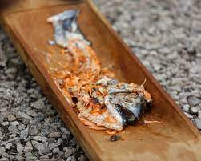
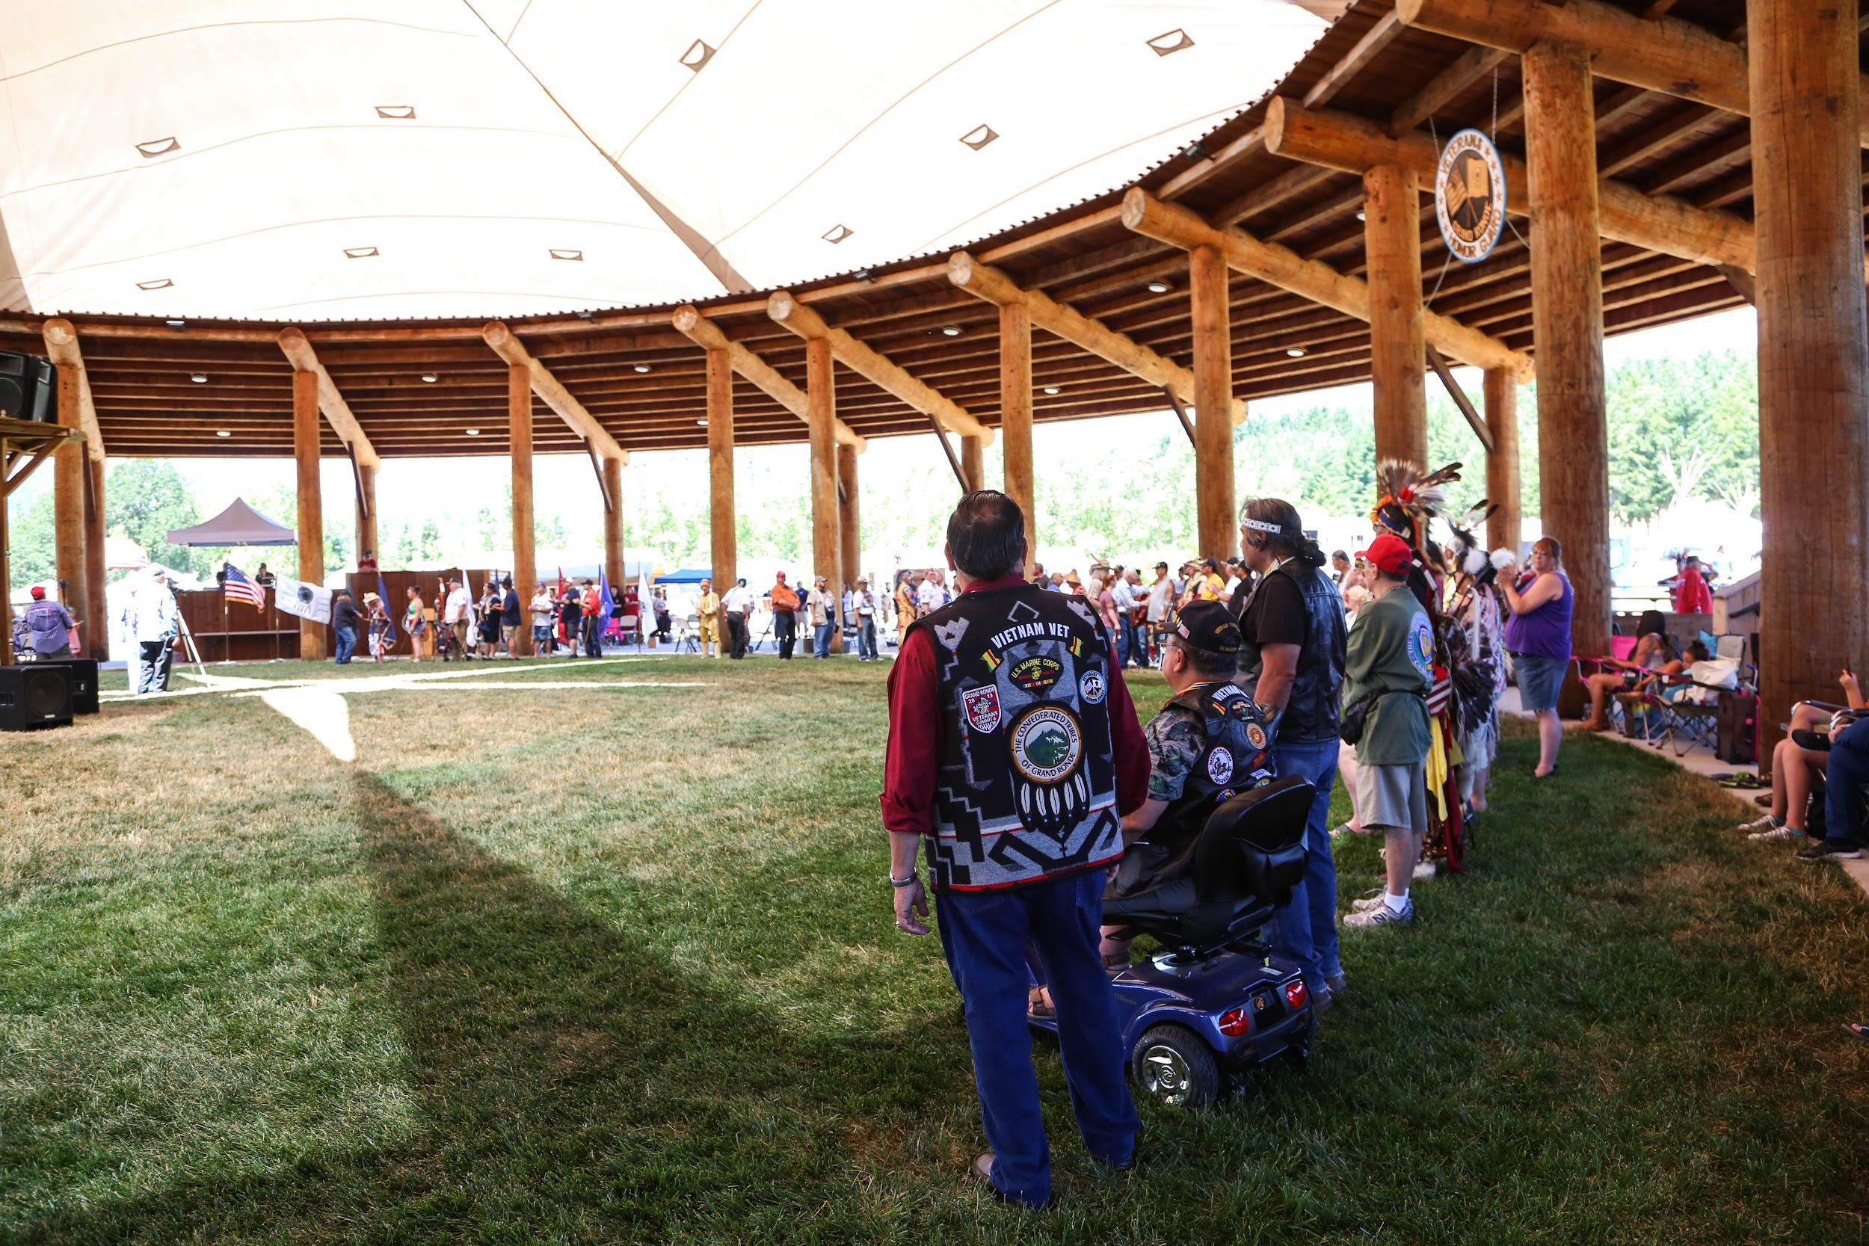
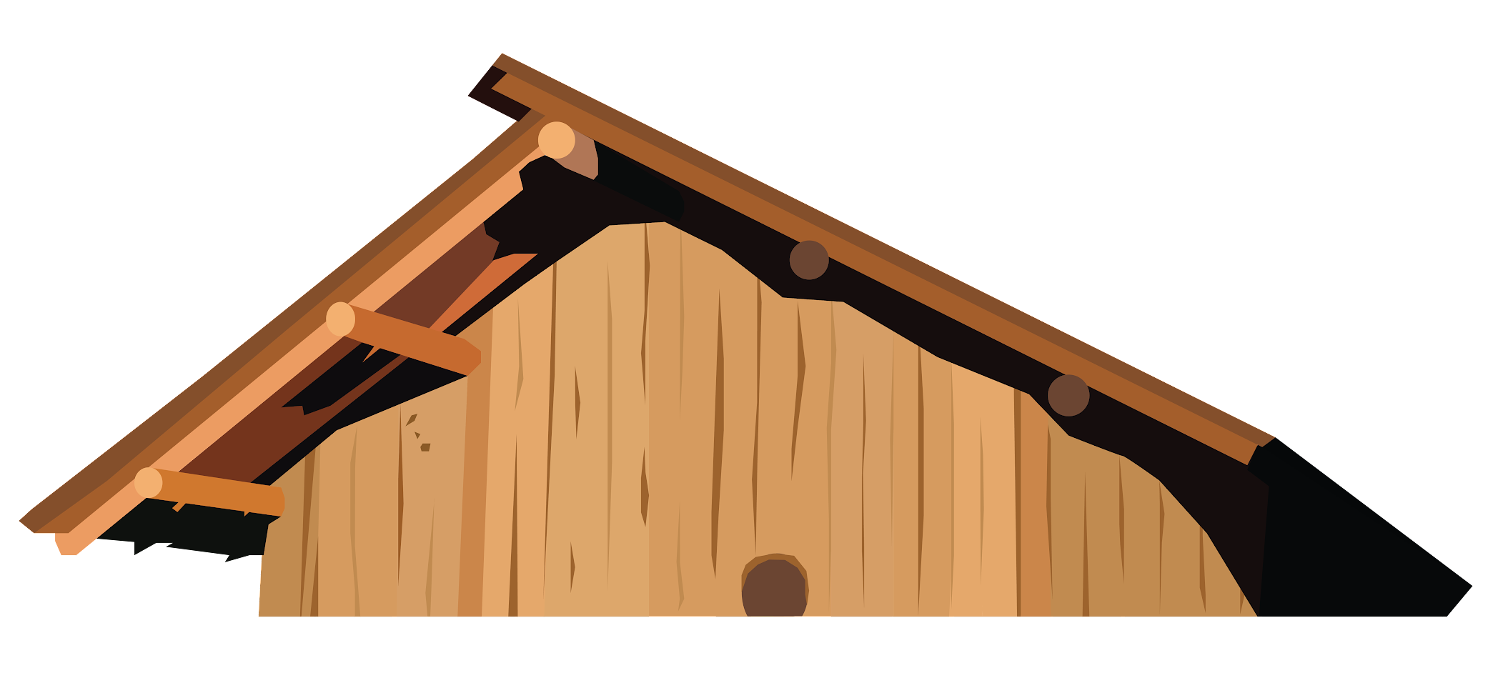
CELEBRATIONS
The Confederated Tribes of Grand Ronde
Your Culture
Notes:
The Confederated Tribes of Grand Ronde has special celebrations in their culture, just like you! Some of the largest celebrations include the First Fish Ceremony, Powwow, and special ceremonies in the plankhouse (i.e. funerals, plankhouse birthday, seasonal changes, etc.)
*What special celebrations do your students celebrate? (holidays, birthdays, etc.) Add these to the “Your Culture” section of the slide.

