Slide 1
Confederated Tribes of
Grand Ronde
Mimicking Animals

Slide 2
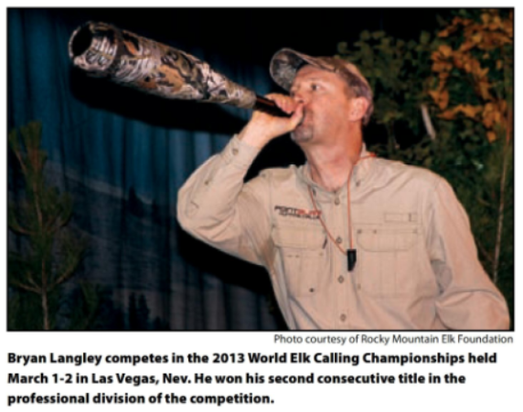

Slide 3
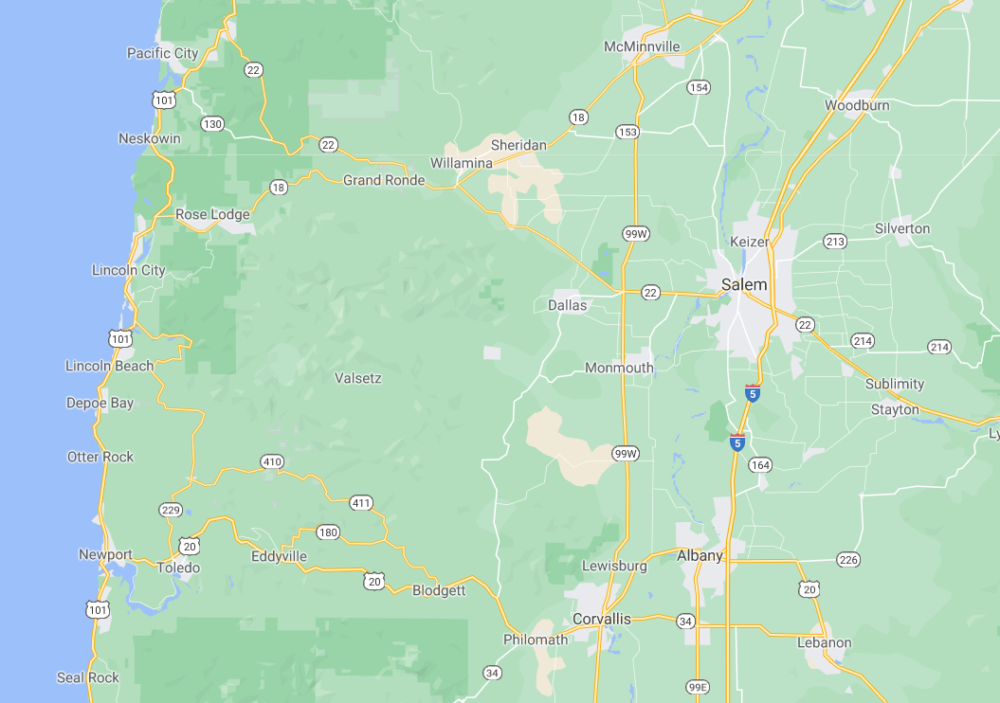

Slide 4
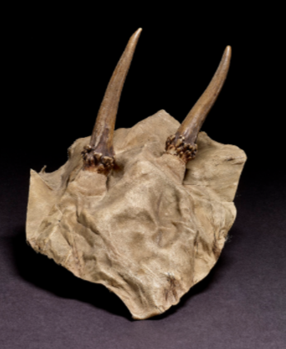
Hunters Cap:
Camouflage
Notes:
This is a hunting cap was an essential part of a man’s hunting attire. It is made using the skin and skull of a deer. It provided camouflage for the hunter.

Slide 5
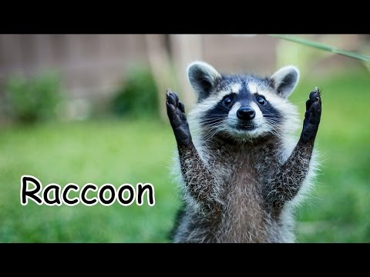
Animals of North American

